Slide 1
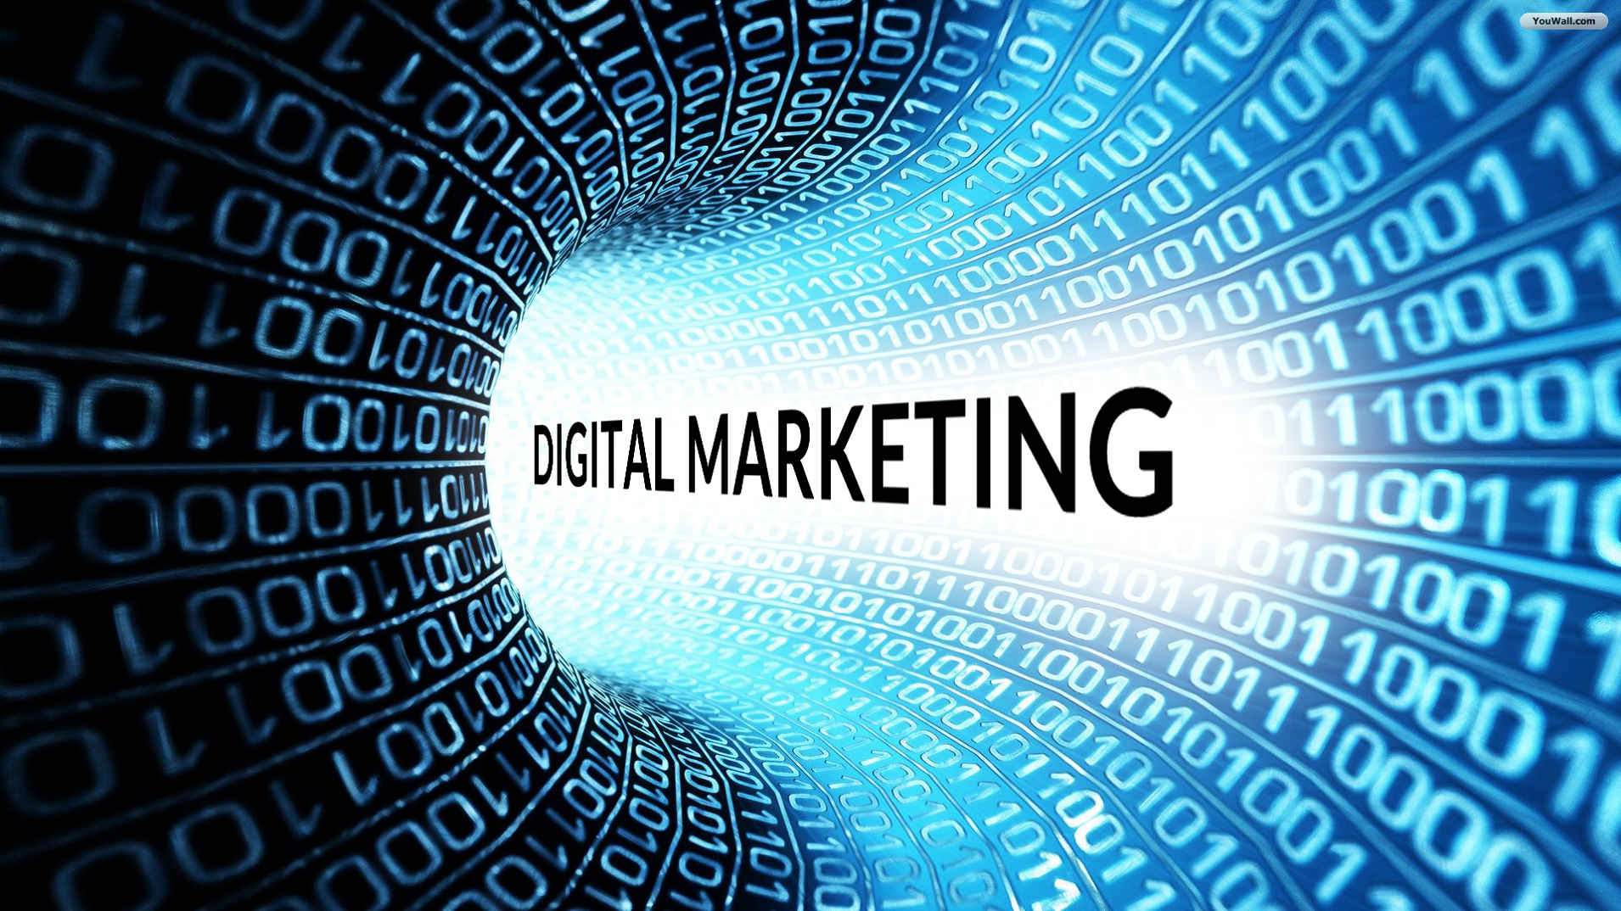
History
Definition
Dimension
How it works
Its Application in Business
Big Data
Presented by: Dr. Frans Budi Pranata
Sage-Fox.com Free PowerPoint Templates

Slide 2

About me
Dr. Fransiscus Budi Pranata SE Ak. MBA
Best CFO 2013 & 2015 as CFO Zalora Indo www.zalora.co.id
CFO Kinerjapay Indonesia
Group Advisor Golden Truly Group & Ecommerce Development
Co-founder Anneavantiemall.com, Webemall.co.id
Before: President Director of Guinness Beer
Doctor in Management Studies, Kaizen SBM, Punai India
Master of Business Administration: Newport University, USA
Bachelor of Accounting, University of Indonesia
Dewan Pembina ADEI Asosiasi Digital Entrepreneur Indonesia
Dewan Pembina Aspirasi Asosiasi Penulis & Inspirator Indonesia
Dewan Pengurus AMA Asosiasi Manajemen Indonesia
Founder Billionaire Mindset Community

Slide 3
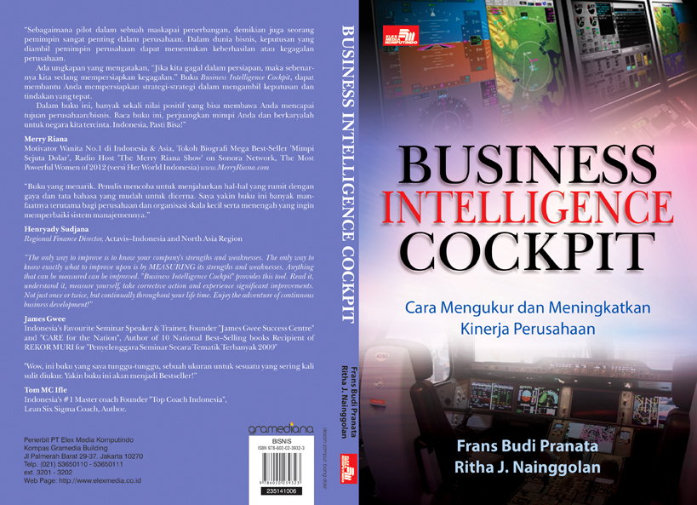

Slide 4
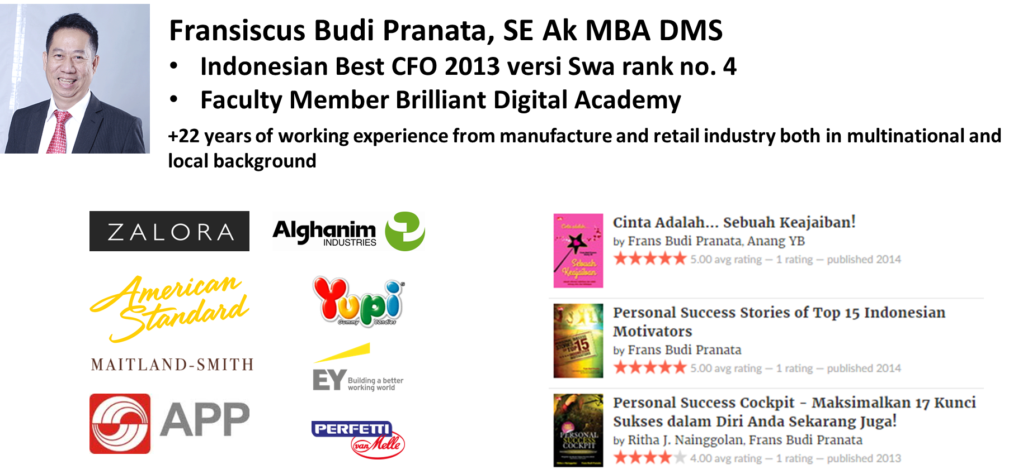
Hello, my name is …
Notes:
Perkenalan diri, penjelasan singkat mengenai profesi dan sejarah perusahaan (5 menit)

Slide 5
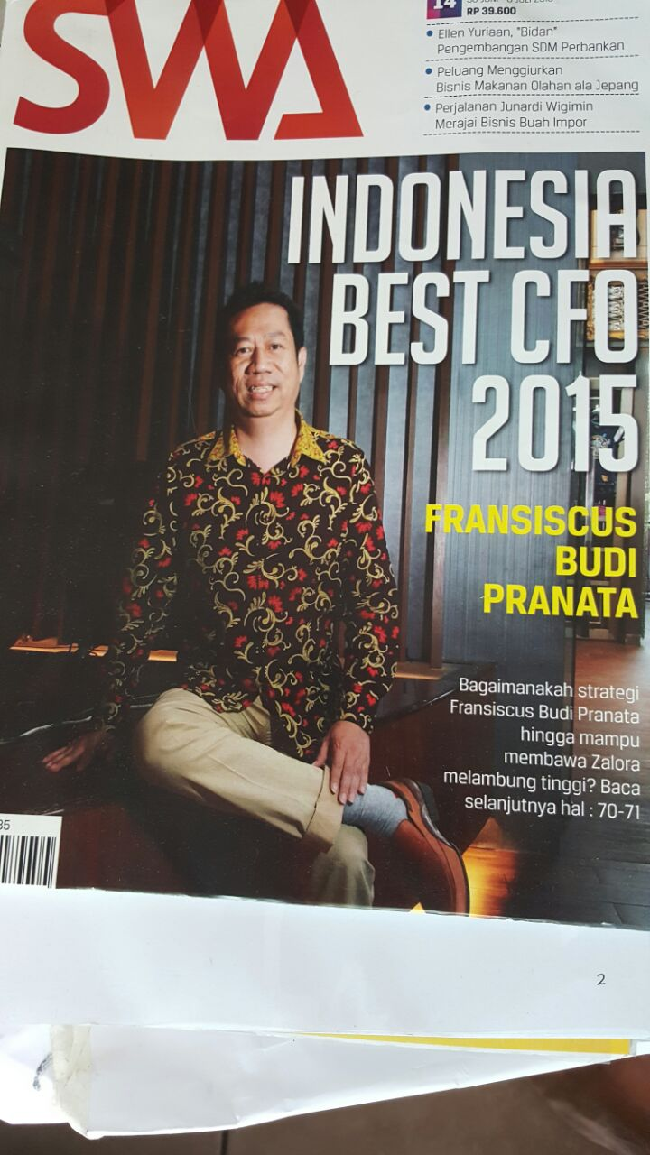

Slide 6

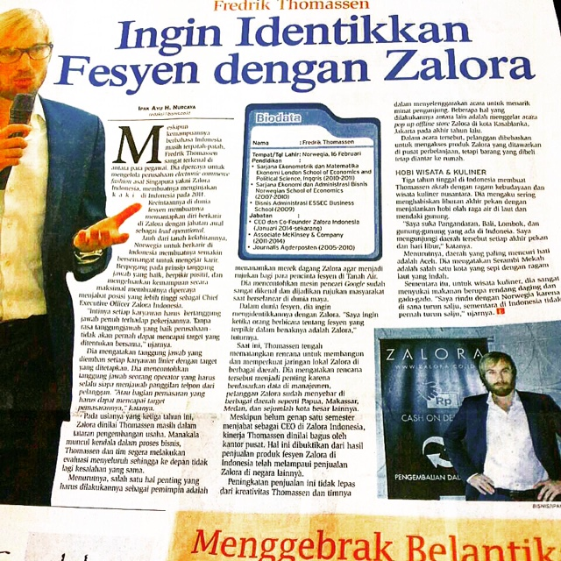
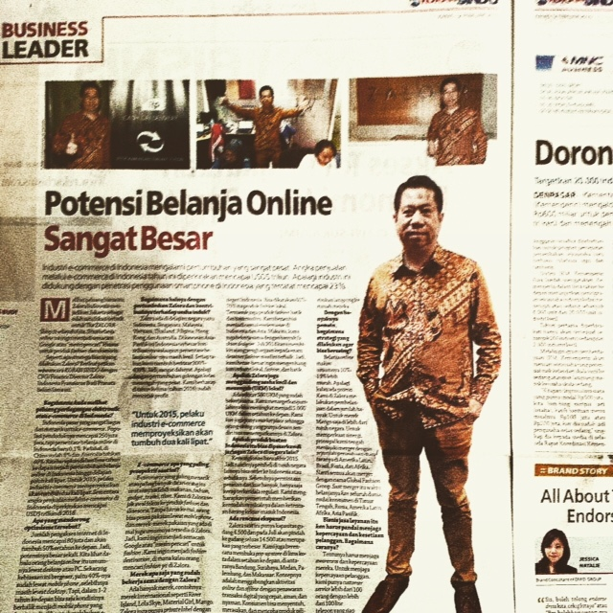

Slide 7
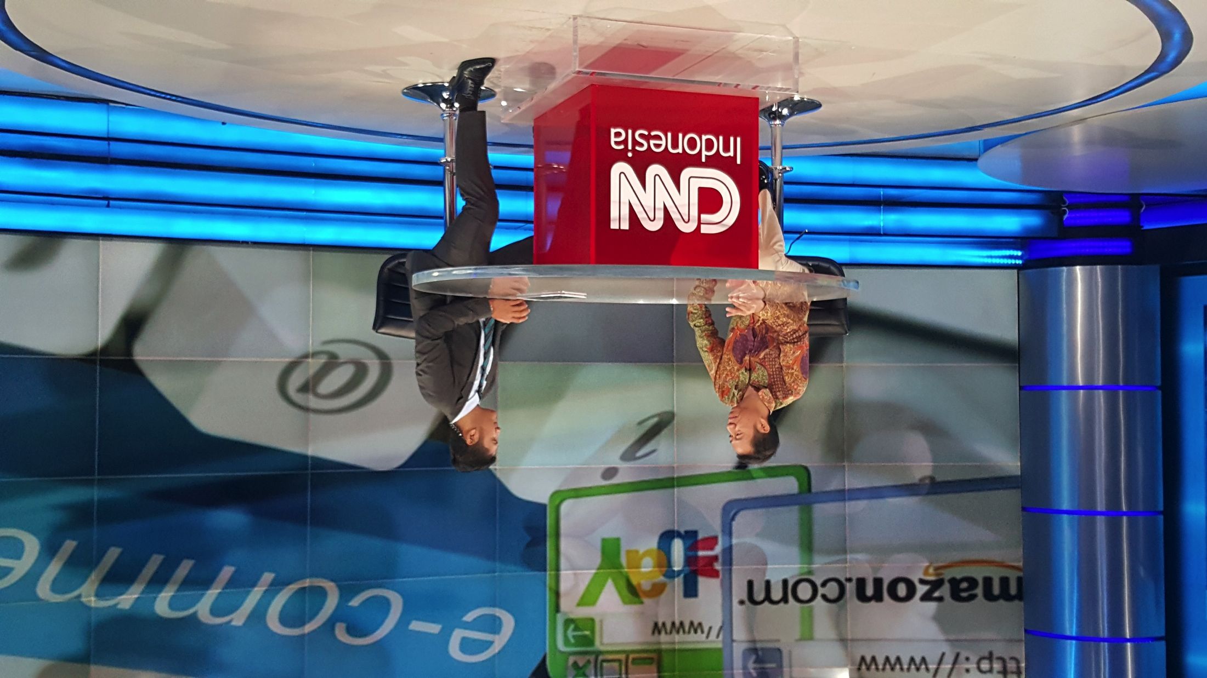
LAZADA ACQUIRED BY ALIBABA USD 1 BIO
THIS WILL ATTRACT MORE INVESTORS
TO INVEST IN SEA & OPEN MARKET
TO MEA COUNTRIES & CHINA.
CNN TALKSHOW ON LAZADA BEING ACQUISITIONED BY ALIBABA
USD 1 BILLION AS CONTROLLING STAKEHOLDER

Slide 8
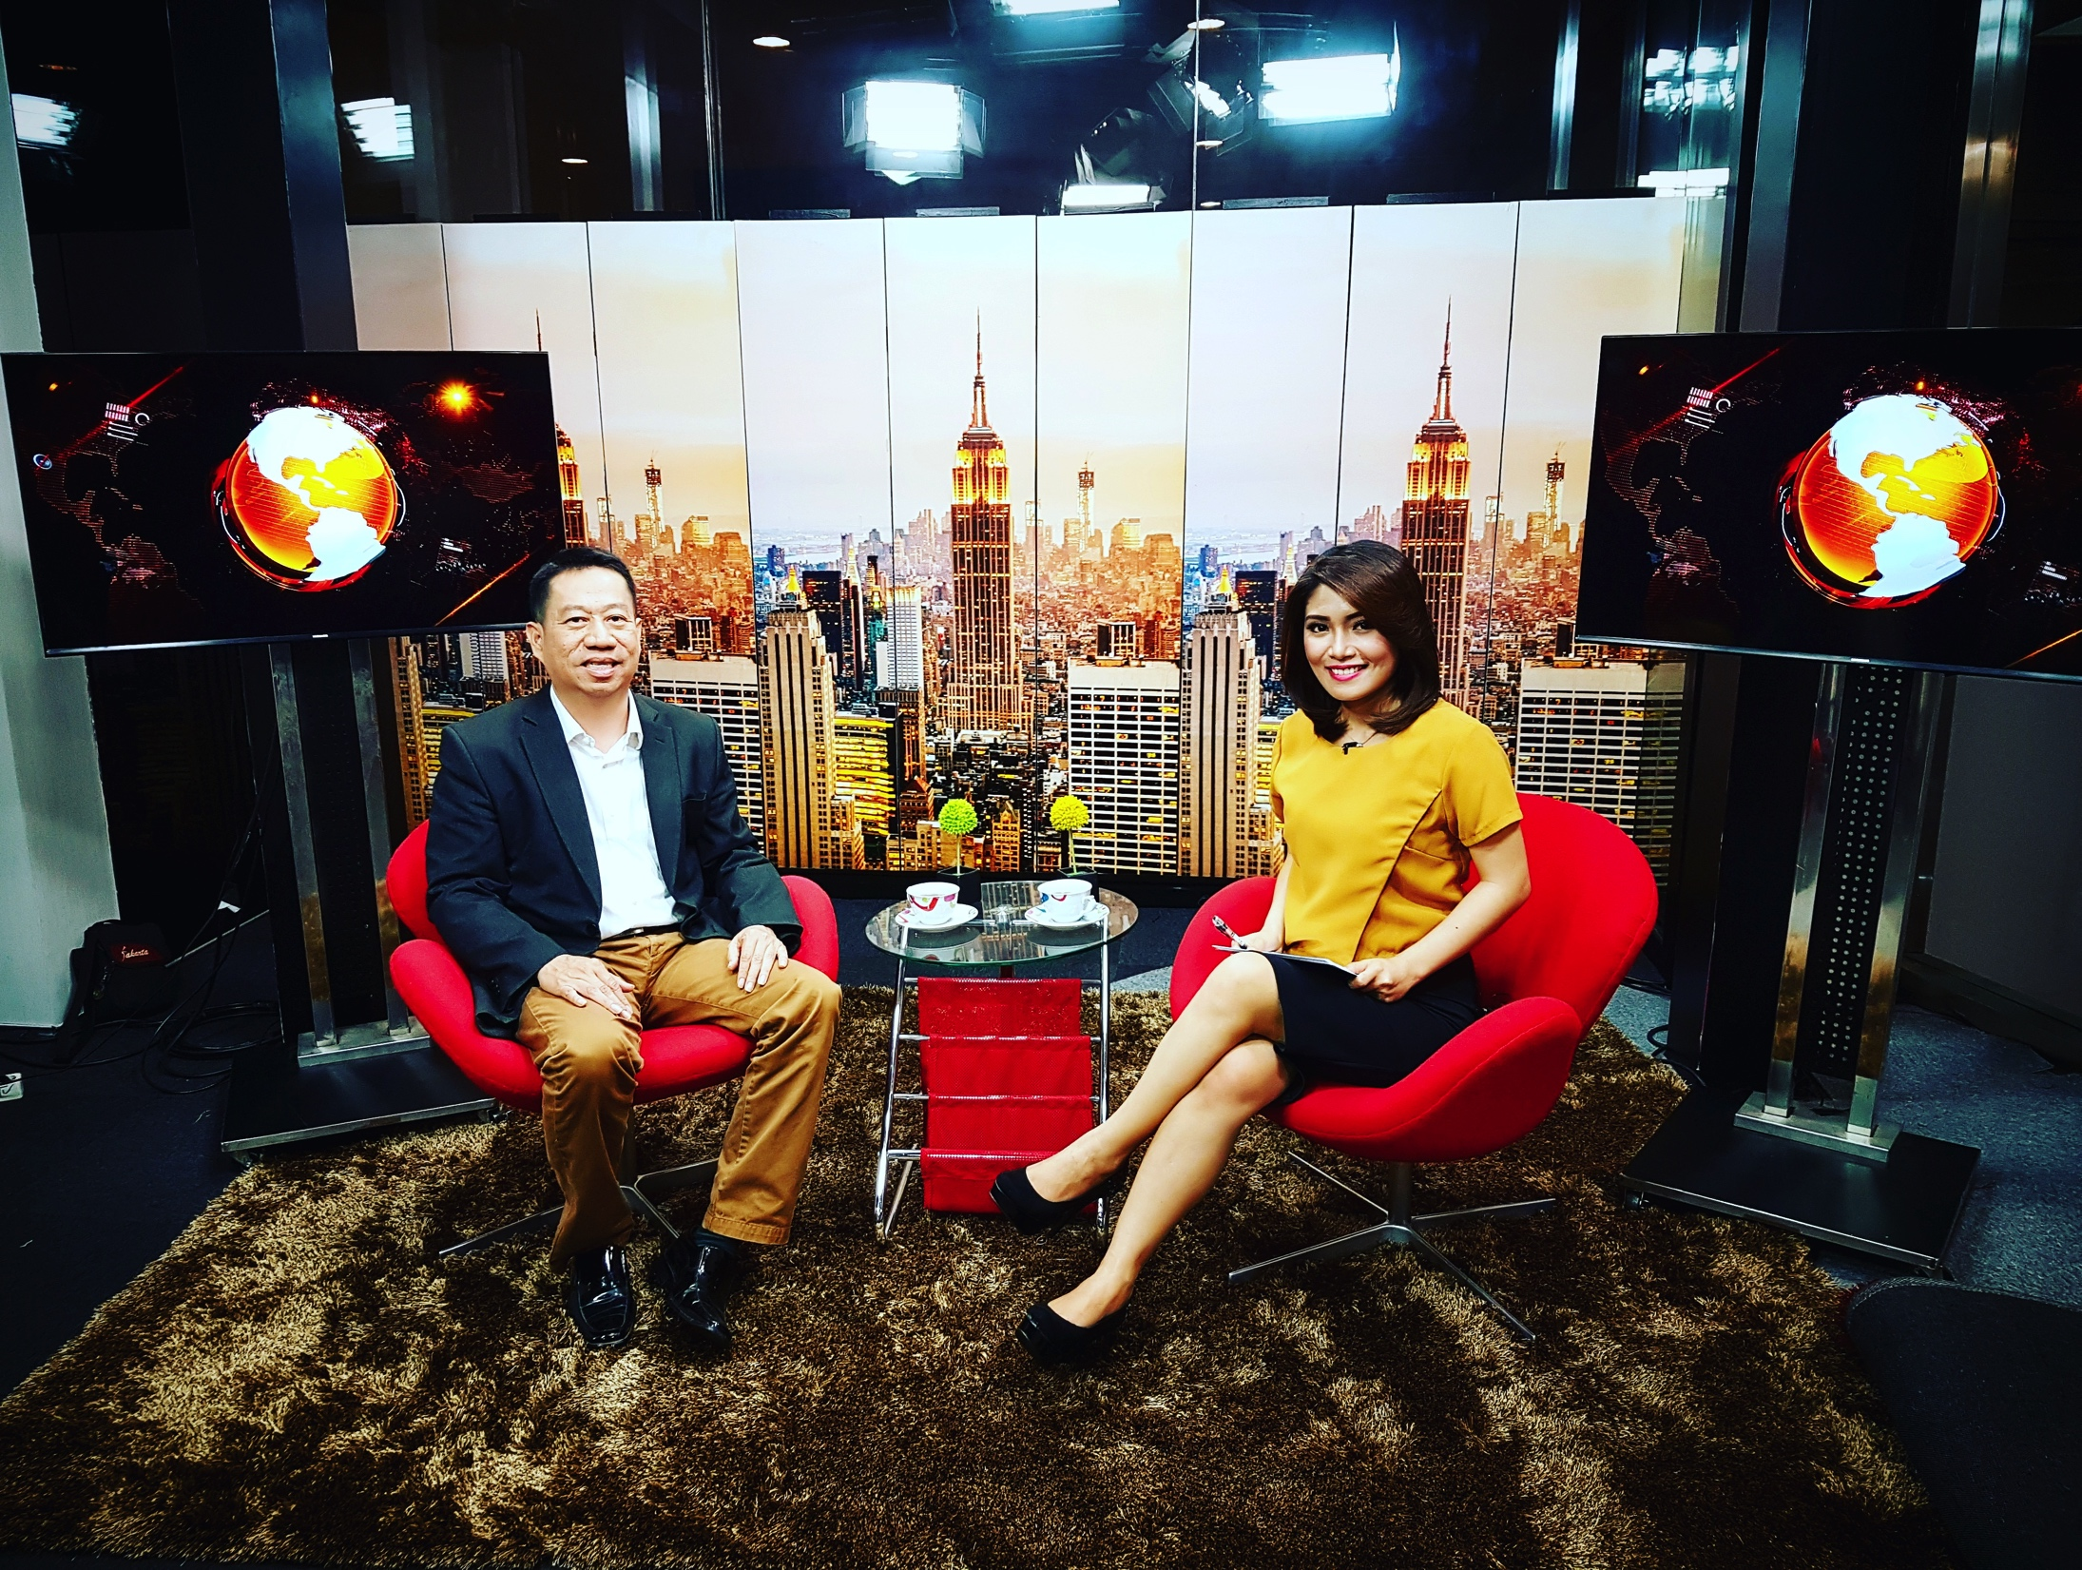
Sharing on Digital
At IDX TV

Slide 9
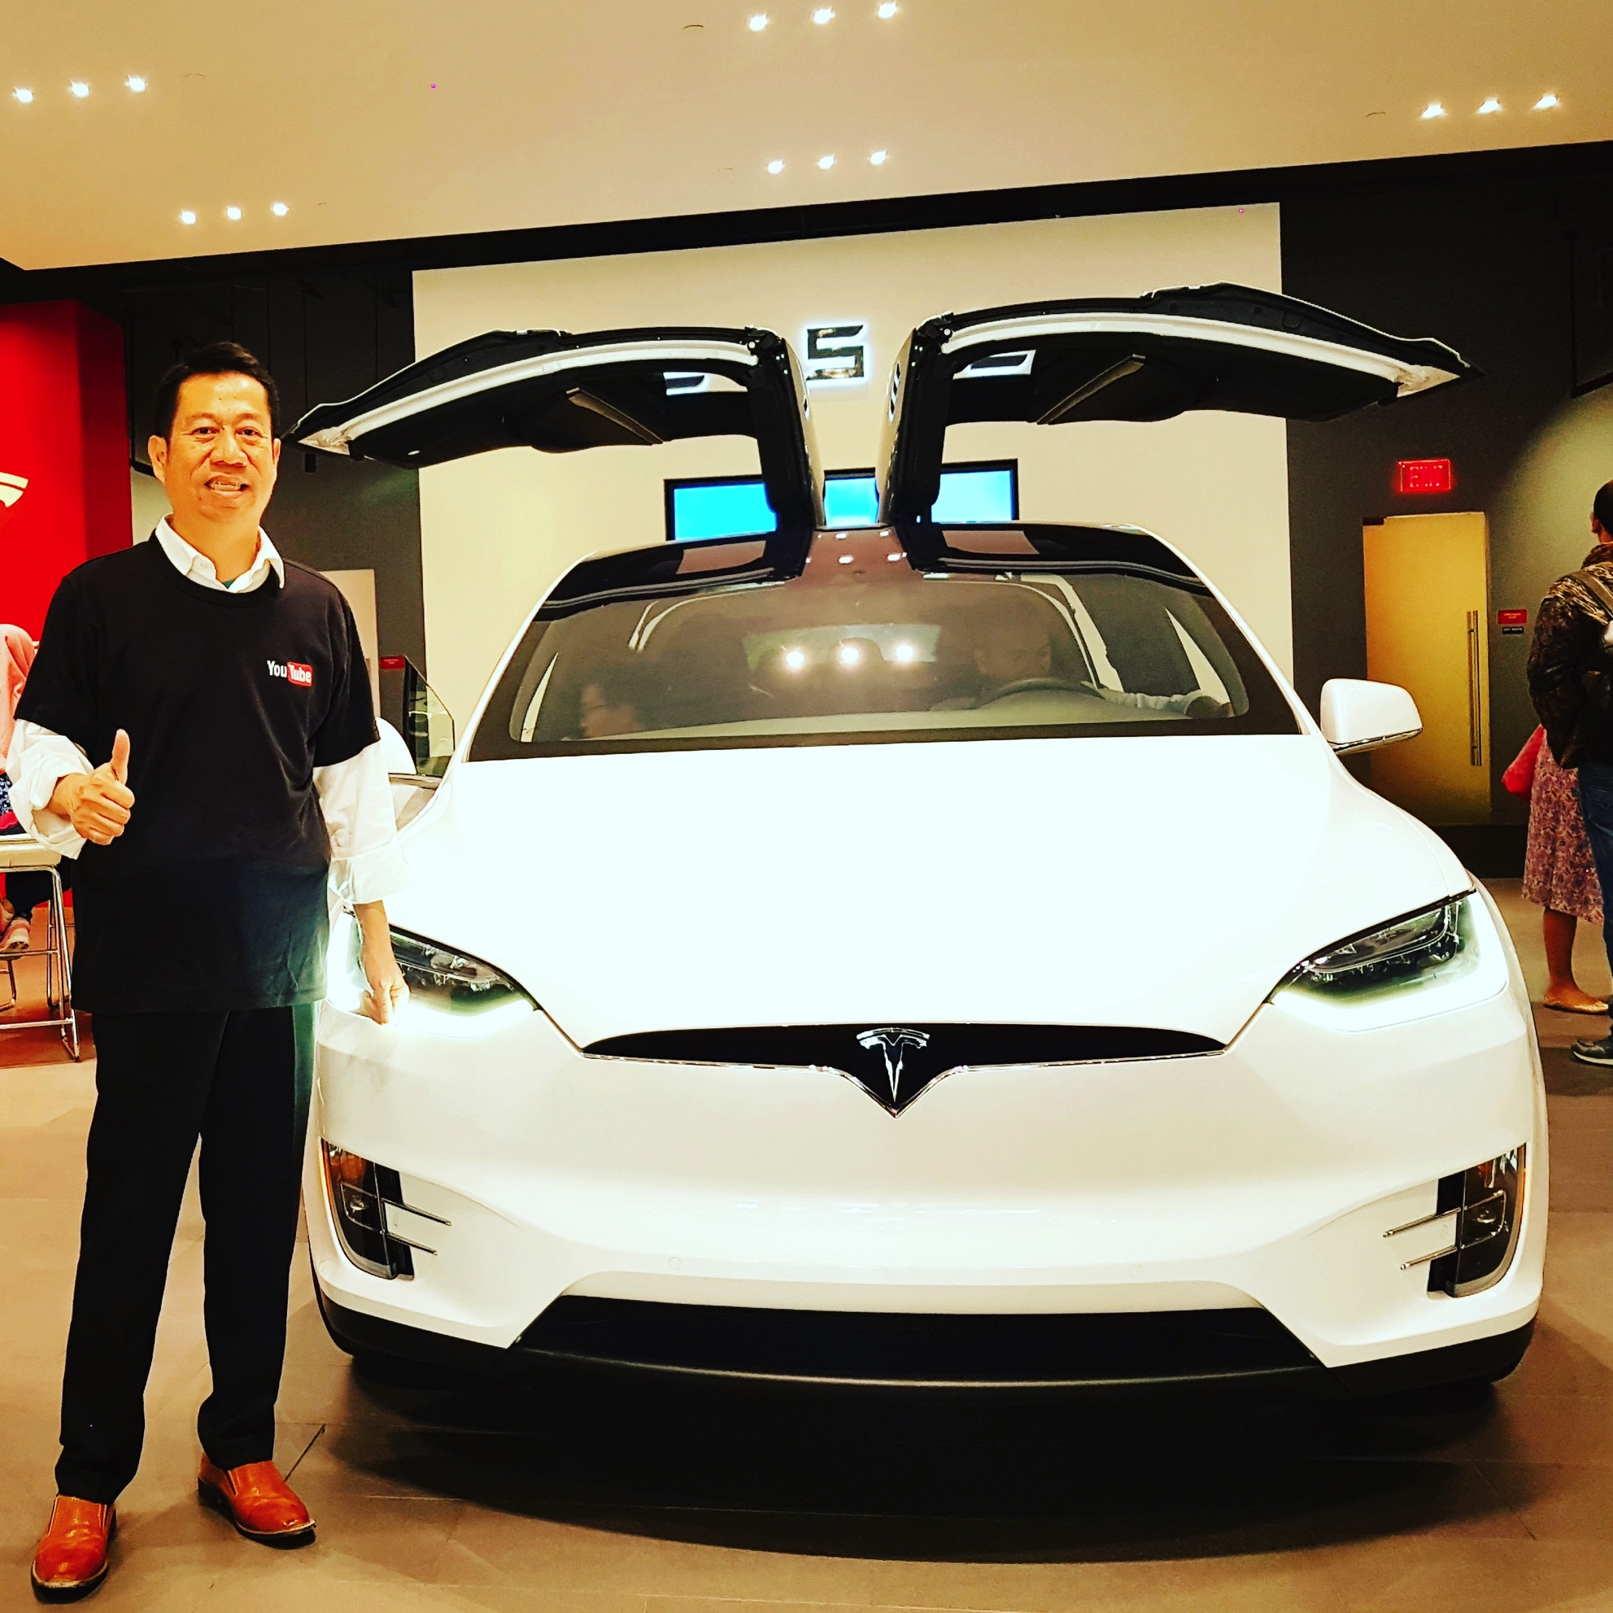
TESLA – ELECTRIC CAR USD 125K 10 HOURS CHARGE – 500 KM

Slide 10
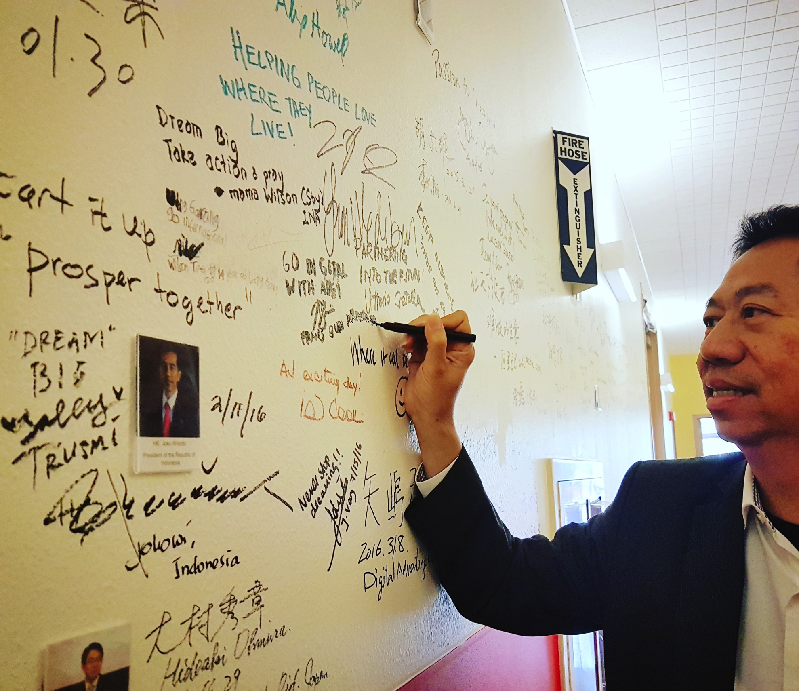
Plug & Play, Wall of Fame

Slide 11
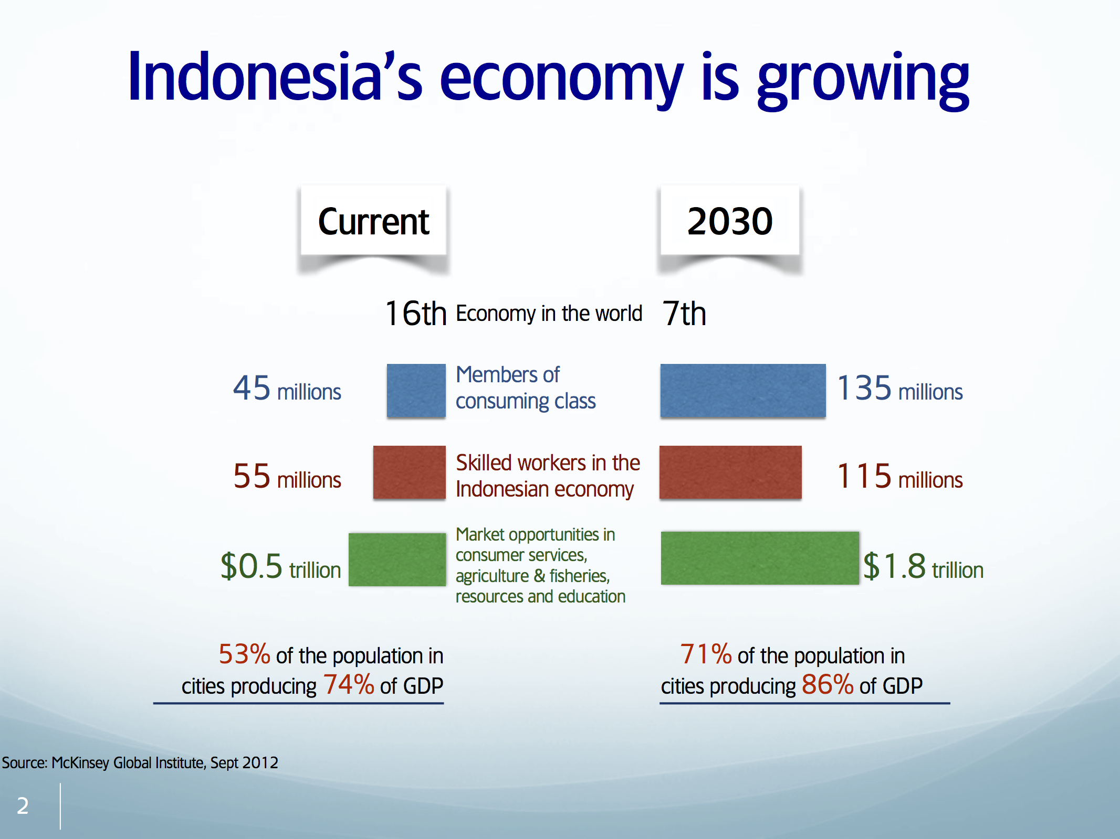

Slide 12
Scarcity of scientists and engineers,
very low spending on R&D
Source: Battelle, 2014 Global R&D Funding Forecast, December 2013: 6.

Slide 13
Indonesia has one of the highest concentrations of wealth
Source: World Bank, Indonesia’s Rising Divide, December 2015.

Slide 14
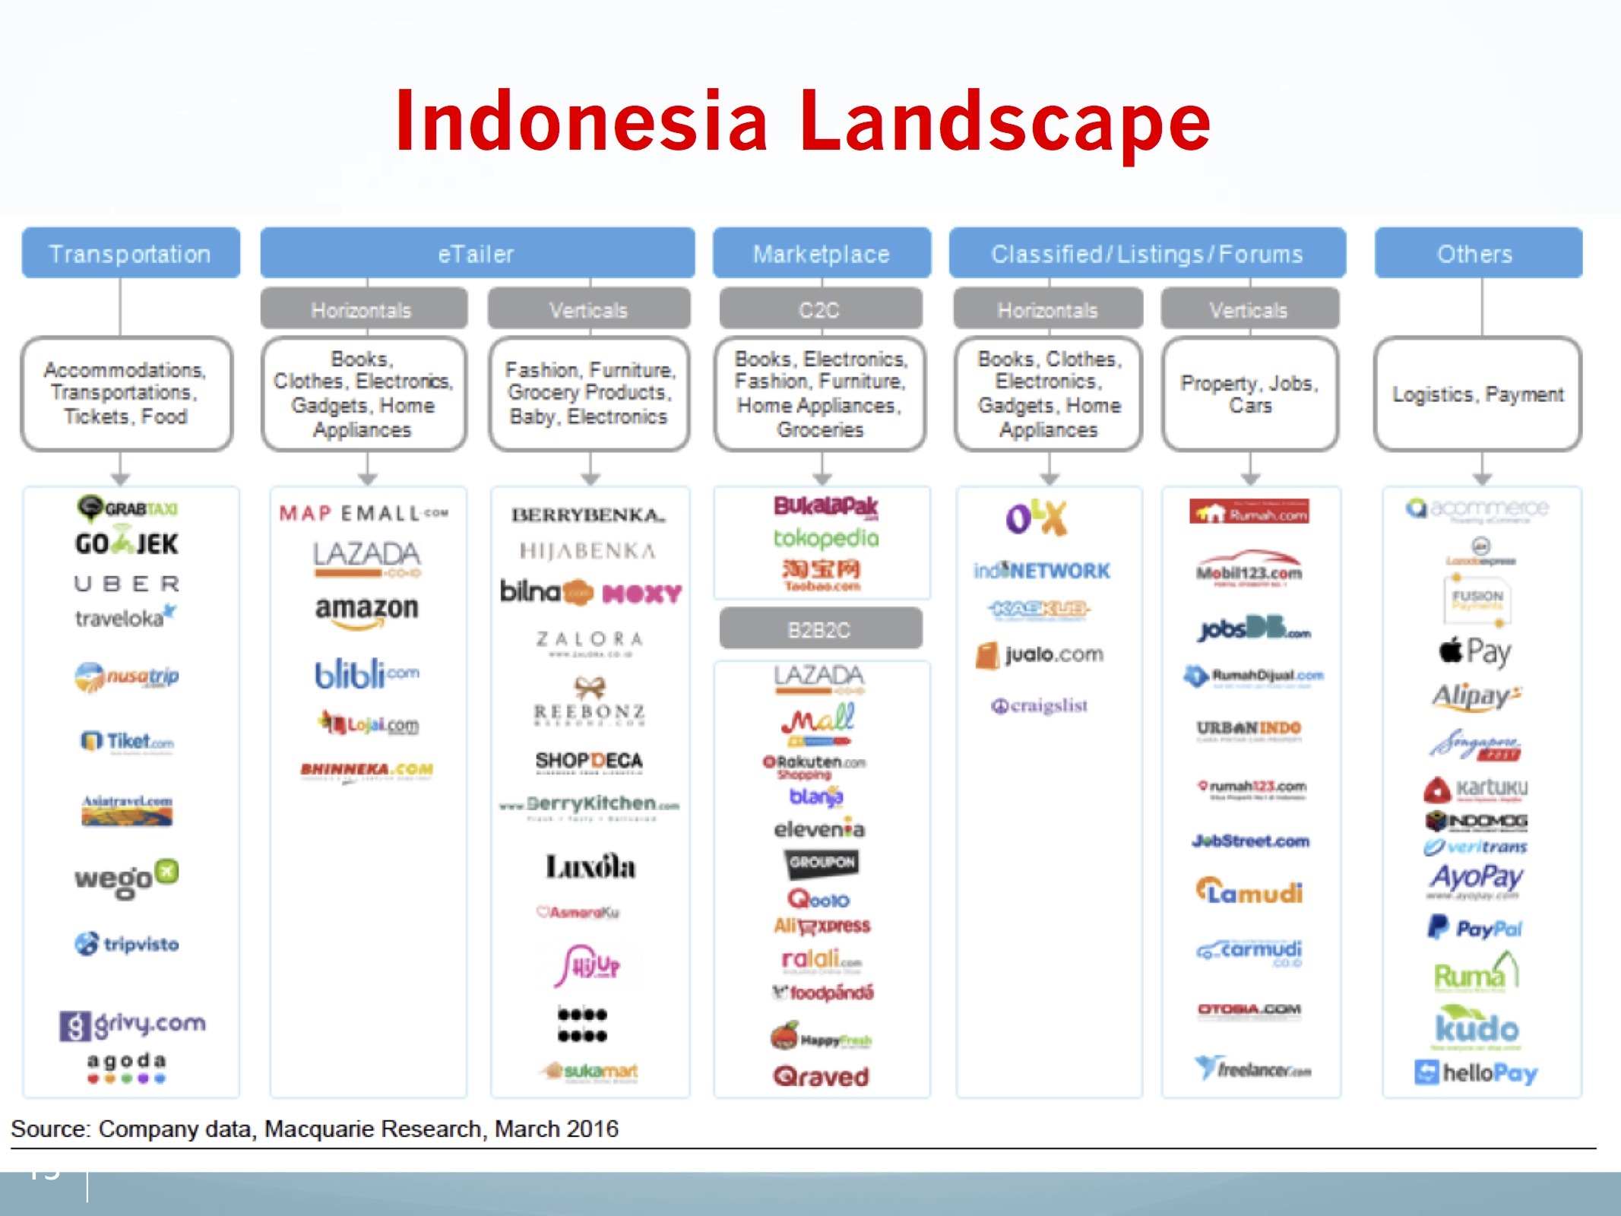

Slide 15

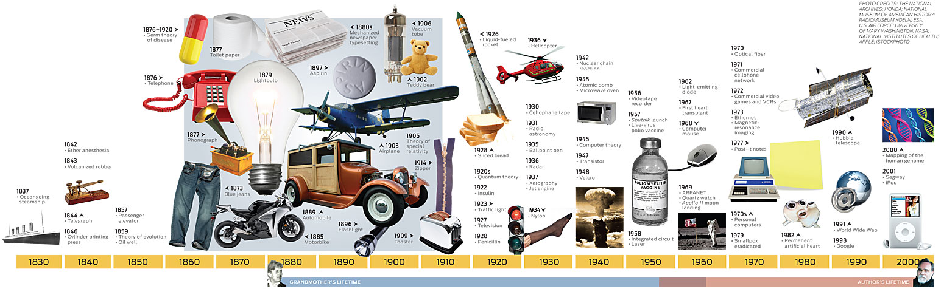
Technology Inventions and Business Opportunities
Sage-Fox.com Free PowerPoint Templates

Slide 16
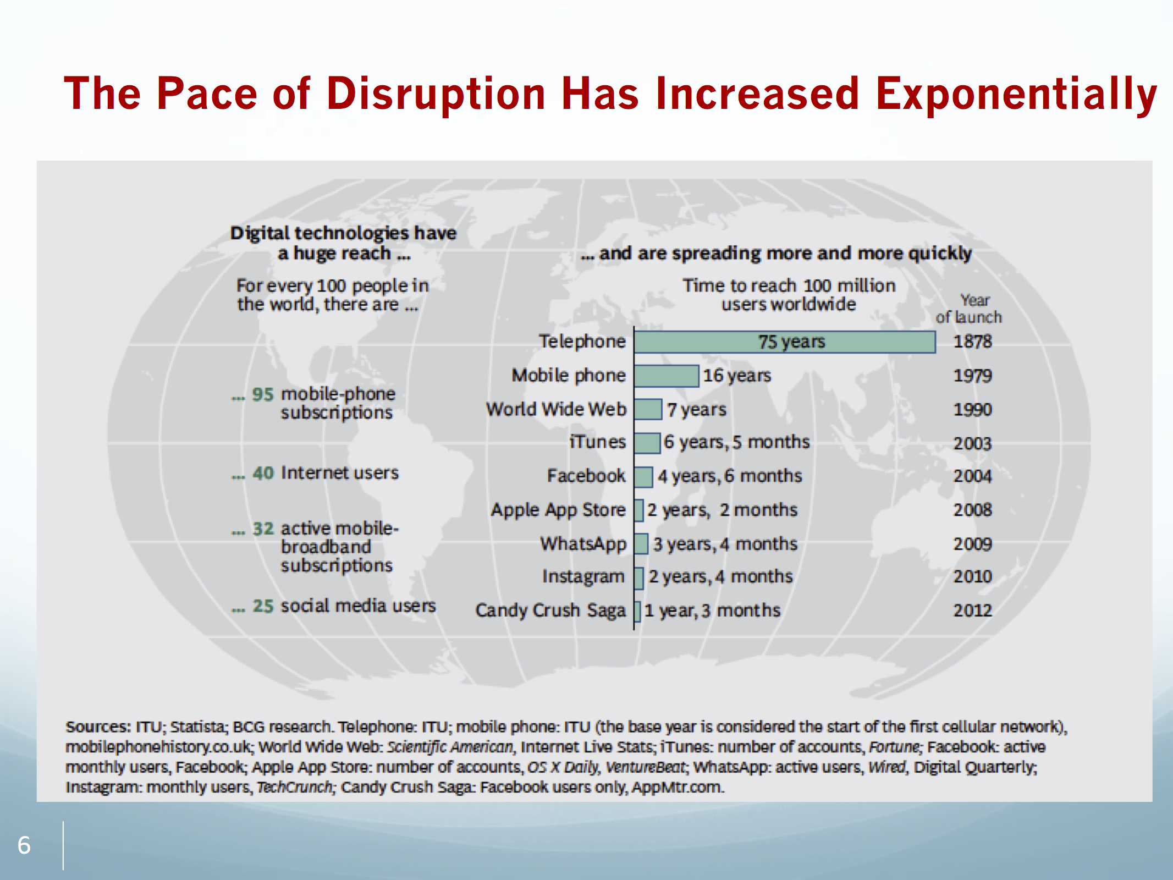

Slide 17

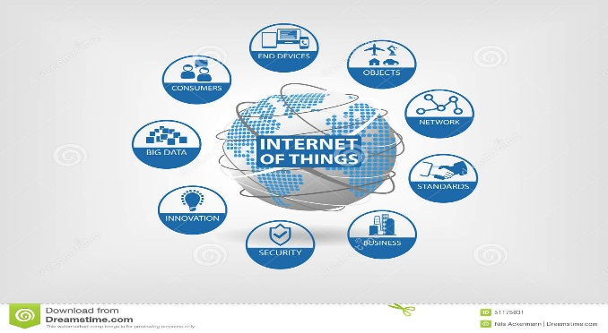



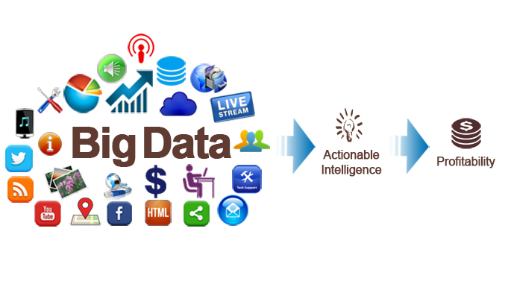



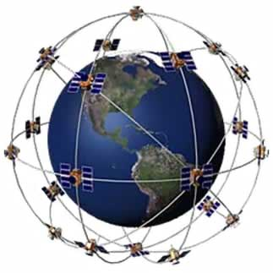
Digital Gold Rush
Mobile Communication
IoT
Big Data
Augmented Reality
GPS
In recent times, a number of handheld mobile communications devices have taken prominence with a significant impact on global business operations..
The IoT creates the ability to digitize, sell and deliver physical assets as easily as with virtual goods today.
(Brody & Pureswaran, 2015)
“Big Data has had a tremendous impact on businesses from customer relations to supply chain operations and will continue to do so”
(Edwin Miller, CEO of 9Lenses)
Augmented reality will have a strong impact on society. The marketing and advertisement fields will explode with augmented reality devices.
The benefits of GPS have grown rapidly with the integration of GPS with other technologies and its wider and deeper infusion into applications.
Sage-Fox.com Free PowerPoint Templates
Notes:
https://www.youtube.com/watch?v=vDNzTasuYEw
Augmented Reality in Advertising
https://www.youtube.com/watch?v=LBLwe8FE_o4

Slide 18
What is big data?
Noun COMPUTING
Extremely large data sets that may be analyzed computationally to reveal patterns, trends, and associations, especially relating to human behavior and interactions.
"much IT investment is going towards managing and maintaining big data"
Sage-Fox.com Free PowerPoint Templates

Slide 19
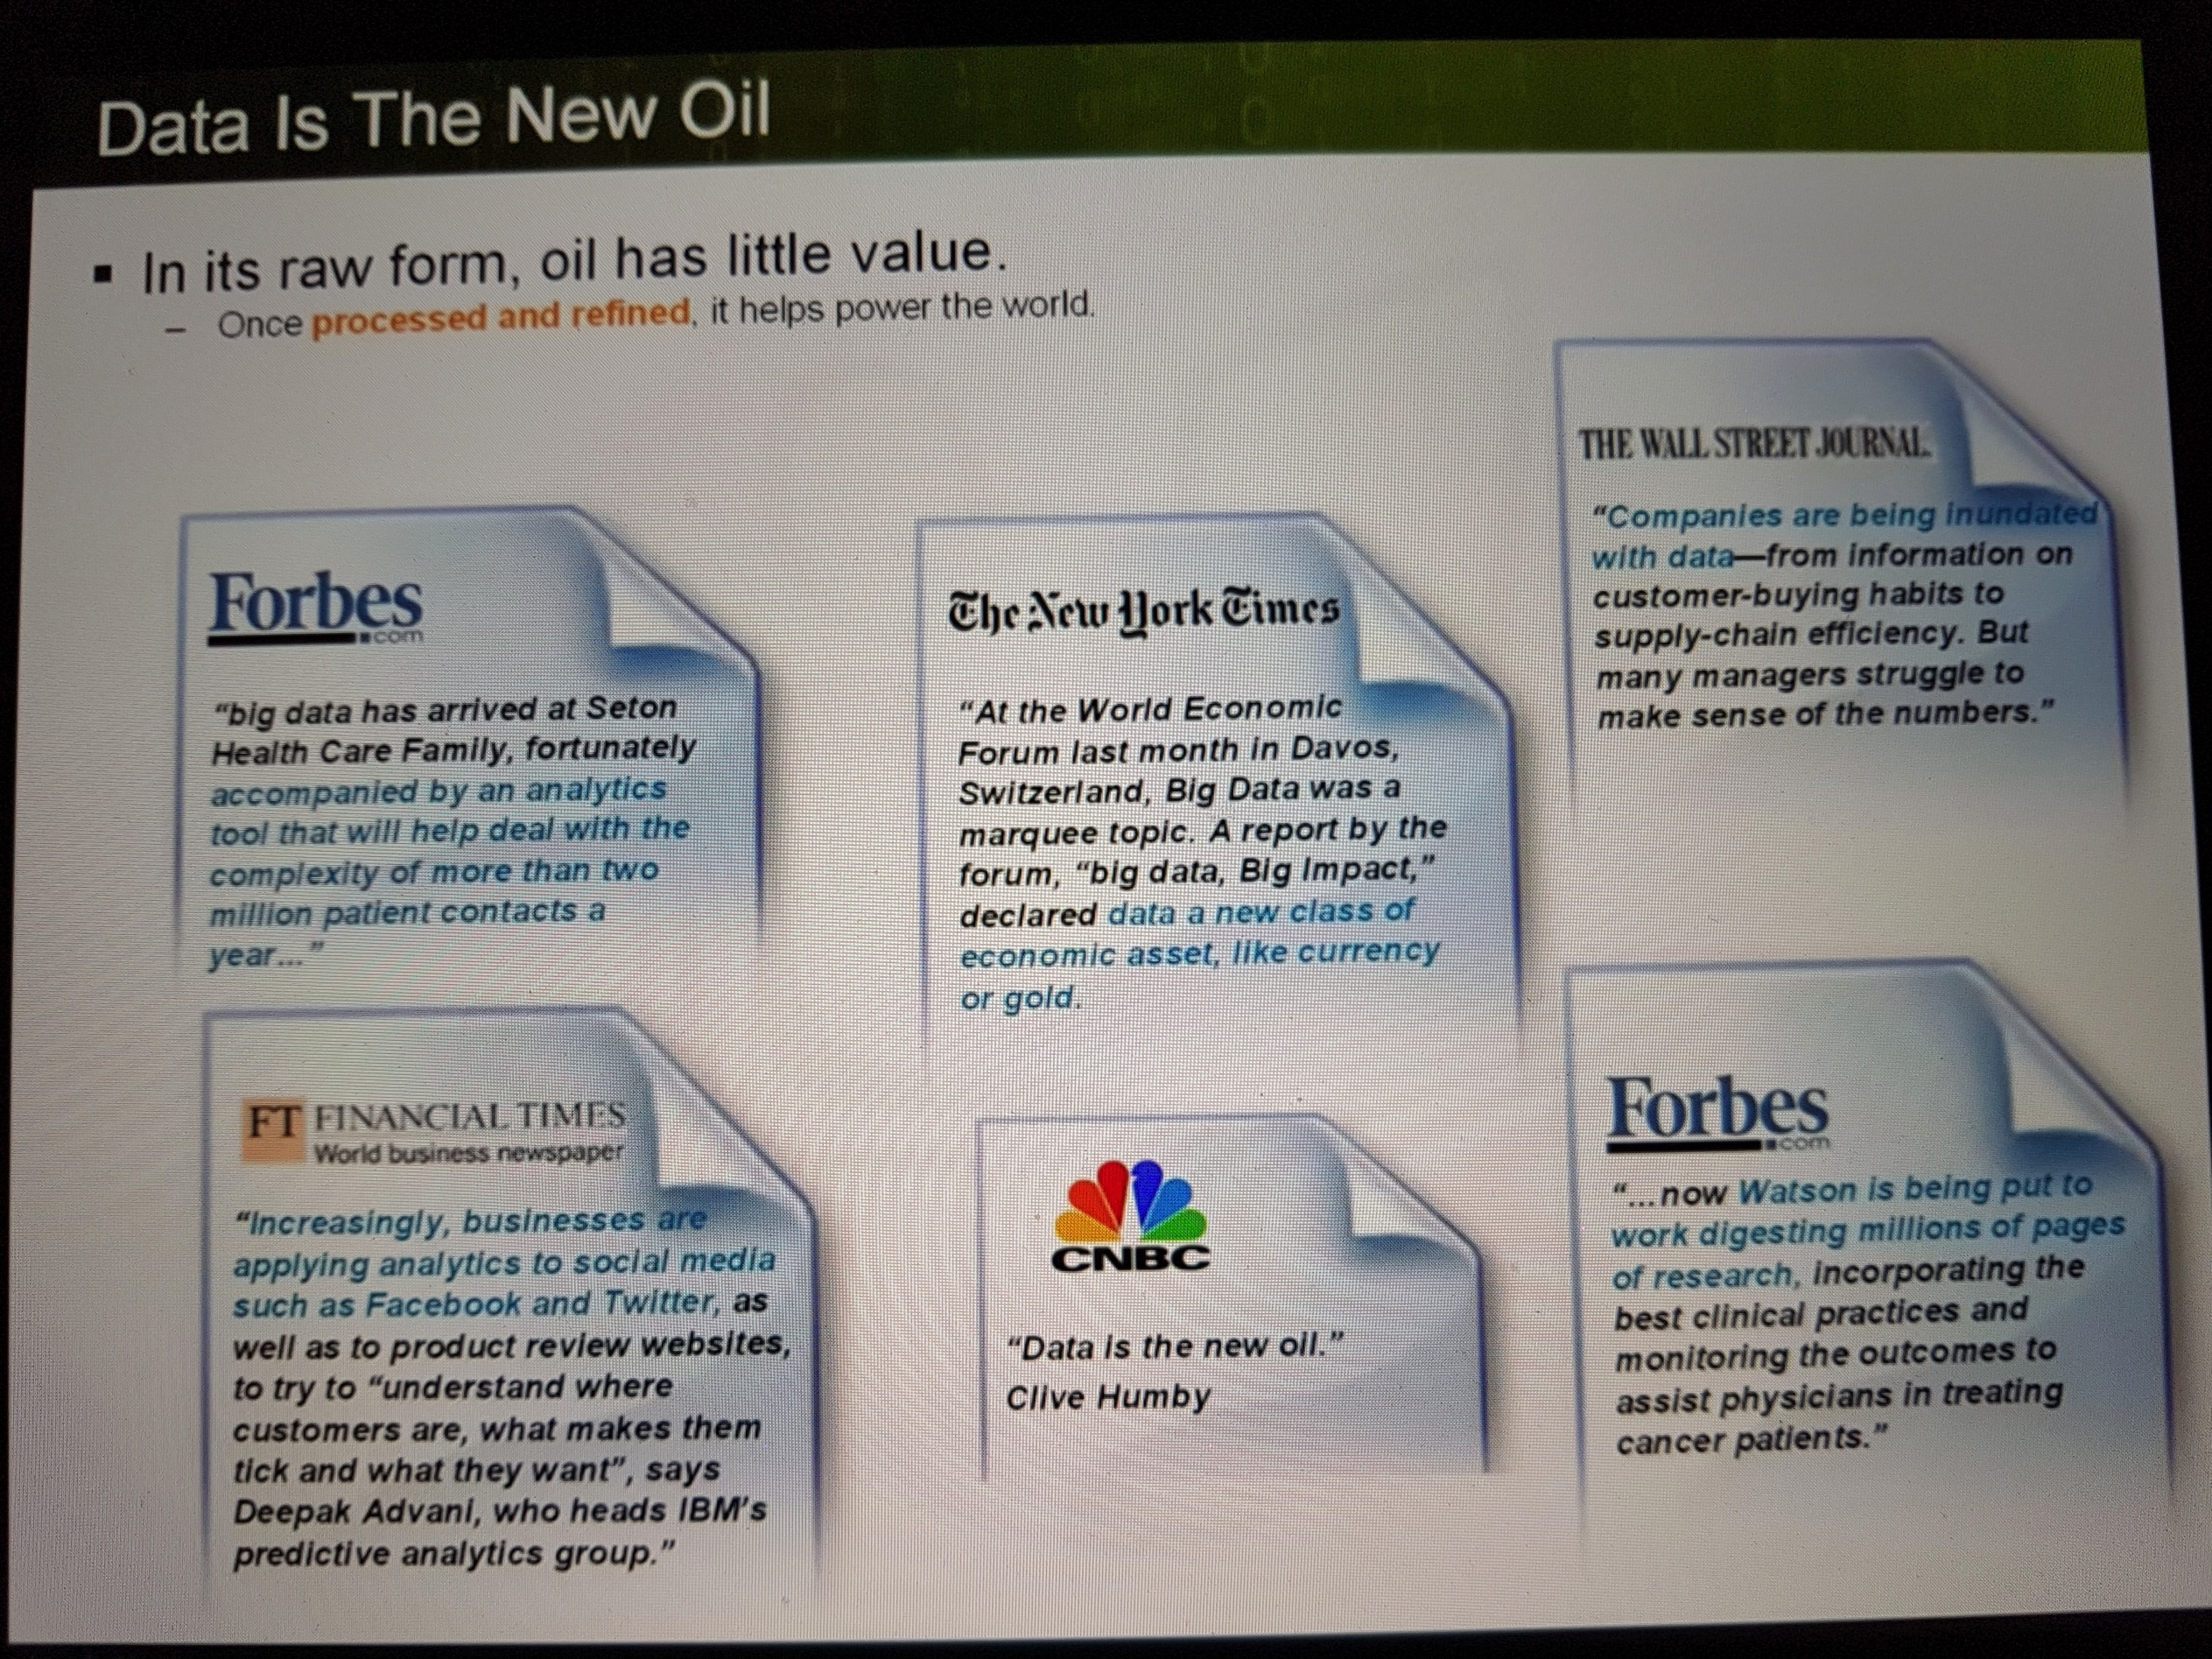

Slide 20
1989
Early use of term Big Data in magazine article by fiction author Erik Larson – commenting on advertisers’ use of data to target customers.

Slide 21
1991
The birth of the internet. Anyone can now go online and upload their own data, or analyze data uploaded by other people.

Slide 22
1996
The price of digital storage falls to the point where it is more cost-effective than paper.

Slide 23
1997
Google launch their search engine which will quickly become the most popular in the world.
Michael Lesk estimates the digital universe is increasing tenfold in size every year.

Slide 24
1999
First use of the term Big Data in an academic paper – Visually Exploring Gigabyte Datasets in Realtime (ACM)
First use of term Internet of Things, in a business presentation by Kevin Ashton to Procter and Gamble.

Slide 25
2008
Globally 9.57 zettabytes (9.57 trillion gigabytes) of information is processed by the world’s CPUs.
An estimated 14.7 exabytes of new information is produced this year.

Slide 26
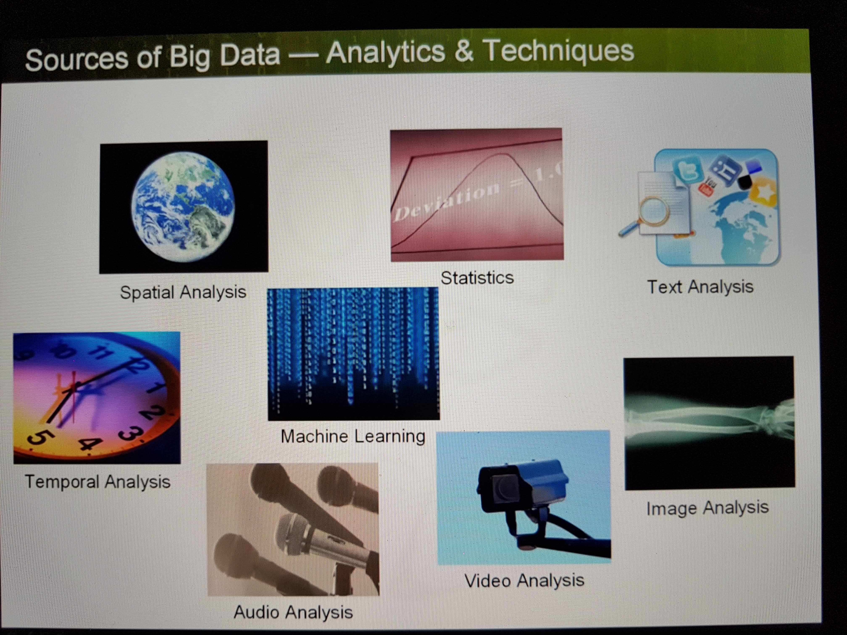

Slide 27
Data Management Challenges
1
Have customers & transactions data, but all data is not there in one place
Data availability
More attention needed in this phase
2
Has partial data warehouse, but it is not comprehensive & data quality is an issue
Data quality
Make Decision
Understand Information
Store Data
Acquire Data
3
Has partial data warehouse that captures information from the source system, but “Know-how” is missing
Adoption
4
Analysis & usage is there, but very ad-hoc. More reports & info than knowledge – lack of accountability
Info. overload
5
Analysis performed in silos unable to support rapidly changing business requirements
Most effort done in this phase
Effect on business
But how about external research data ???

Slide 28
Business Challenge
Lead
Coverage & Hypnosis (Physical Network, Channel, Marcomm, Perception, Mind, Physiographic, Lifestyle)
Five Pillars
Business Framework
Net Value
Margin%
(Tariff, Efficiency, Risk, Rewards)
Conversion
Acquisition% & Retention% (Sales Method, Product, Services, Channel, Quality, Convenience, Pricing)
Frequency
Frequency
(Availability, Success rate, Speed)
Amount
Amount
(Nominal Variation, Service Packaging, Bundling)

Slide 29
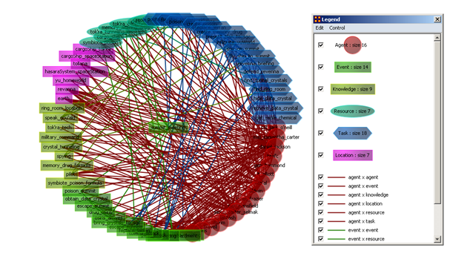
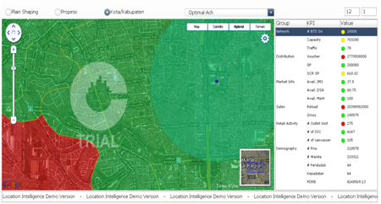
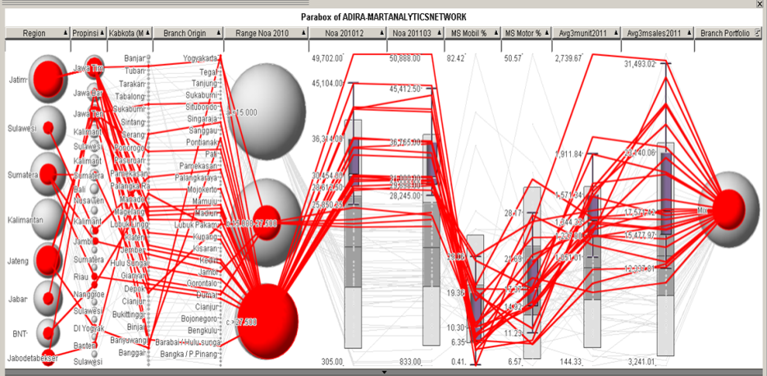
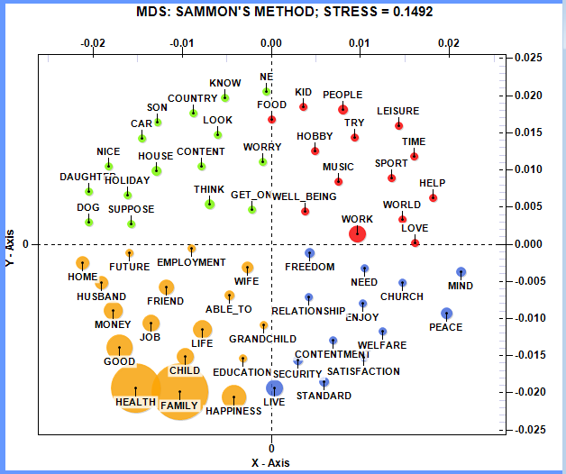
Advance Analytics Challenge
DNA
Location Intelligence
Visual Analytics
Collective Intelligence

Slide 30
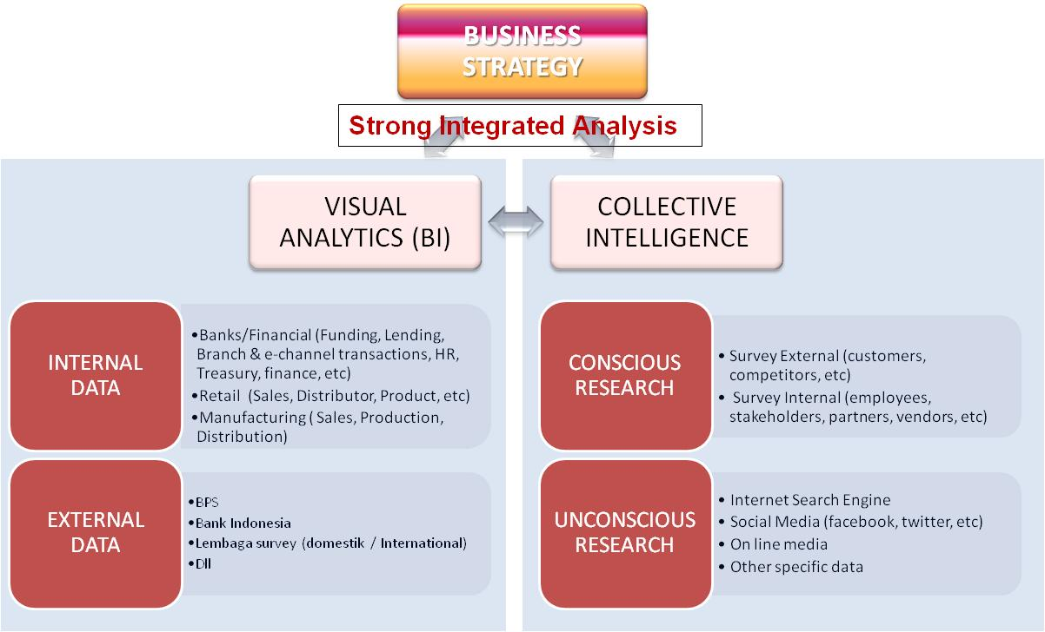
Business Justification Analysis

Slide 31
Collective Intelligence (CI)

Slide 32
External Research Data Source Sample
The largest consumer database in Indonesia with hundreds million individuals complete with all their demographic information such as age, marital status, professions, among others.
PLN usage data in every Kecamatan, Polreg data from every Samsat, Funding and Lending Composition from Consumer, SME and Corporate Banking, etc
Massive consumer database along with census data is plotted in a dynamic GIS mapping software to visually understand your strength, opportunities, threats and weaknesses in every “kecamatan” or “kelurahan”
Terabytes of online and offline media data from 2004 until this morning’s data. Simply, every written word in the country, online, offline and anywhere in between.
Over 2.7 billion words of what people search from leading internet search engine such as Google,Yahoo, etc. With 35 million Indonesian internet users.
Social Network information from leading Digital Social Media such as Facebook, Twitter, etc and also what they talked about

Slide 33
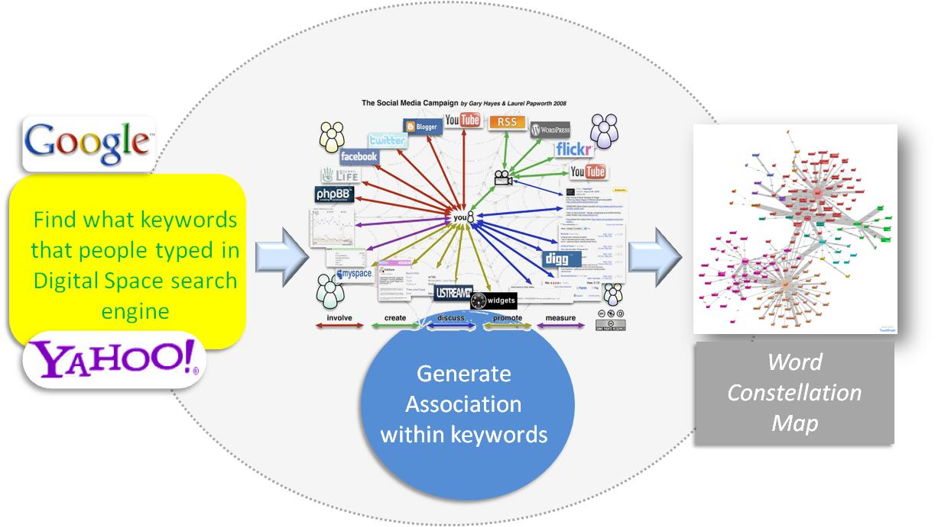
Fact Finding through Collective Intelligence
Preliminary research

Slide 34
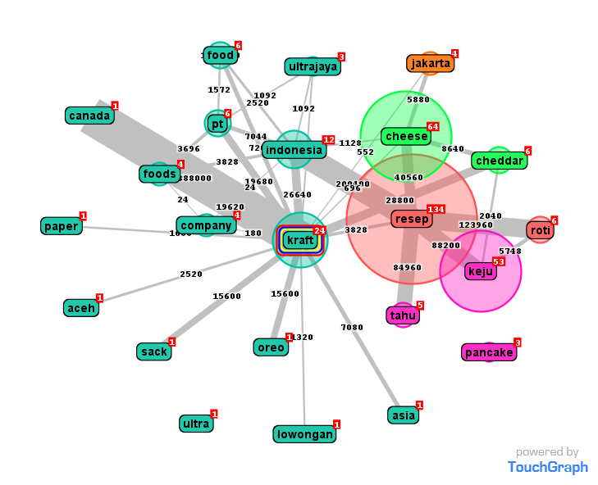
What they perceive about your brand…
ILLUSTRATION : The most keyword that people typed in Google about Brand Cheese X is “Resep”
BRAND
Brand X
What’s on People’s Mind about Brand X ?
Is it inline with their Campaign ?
Suggested campaign direction : Resep → Keju → Brand
Instead of : Brand → Resep → Keju

Slide 35
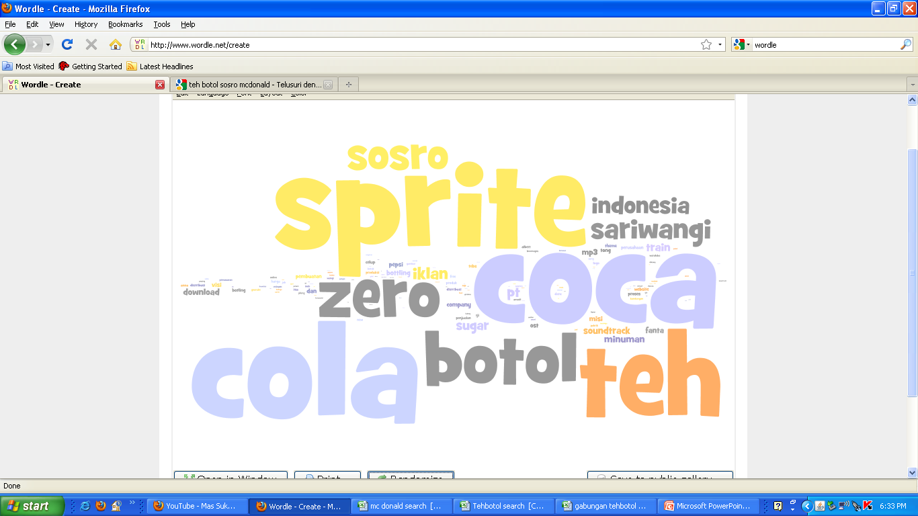
What they associate closely to your brand…
ILLUSTRATION : The most keyword that people typed in Google about Minuman Botol is “Coca Cola, Sprite, the botol” bigger the words, the more often it was typed
We know our nearest competitor? What we want to position our brand?

Slide 36
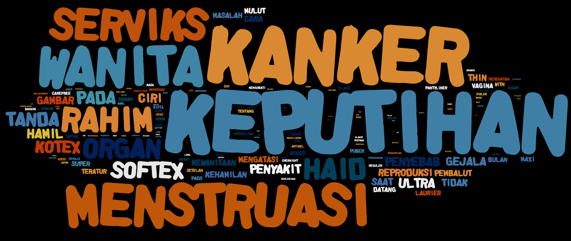
What people perceive about Pembalut……
ILLUSTRATION : When typed ‘pembalut’ the main associated keywords are ‘keputihan, kanker, menstruasi’ bigger the words, the often it was typed
Have they address these issues / opportunities

Slide 37
Conversations of a single twitter account
Who are your key opinion leaders & followers…

Slide 38
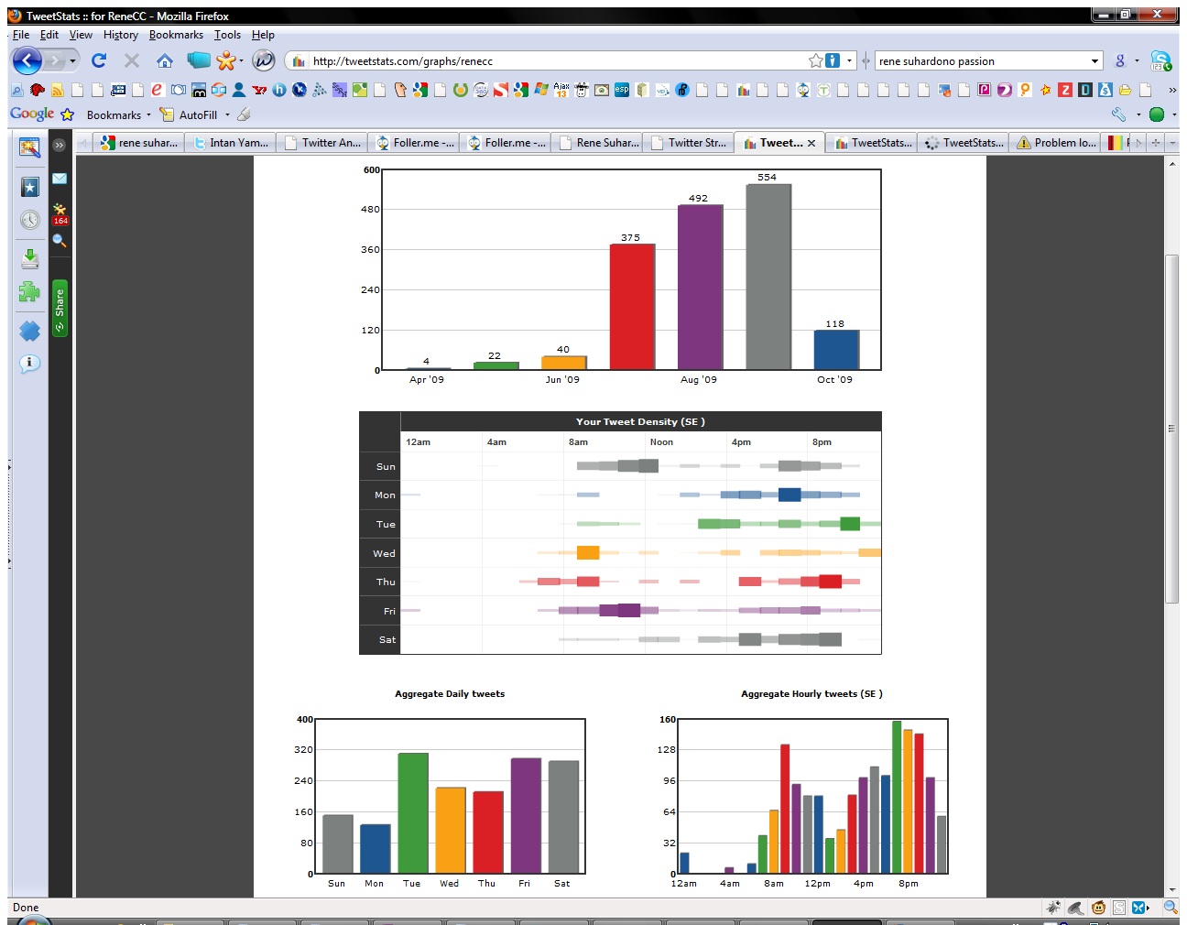
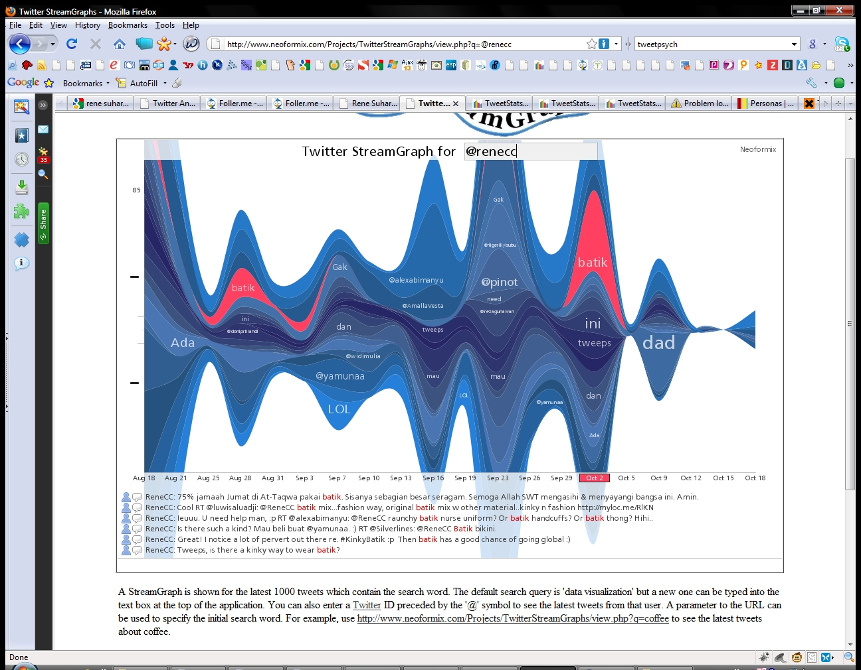
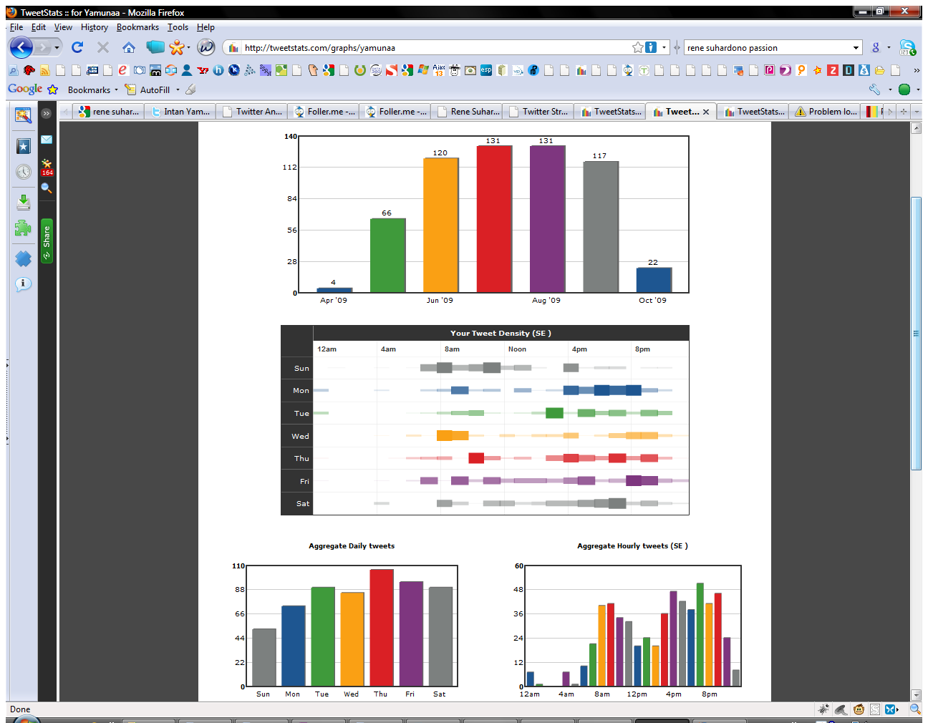
Who Talk About What and When…

Slide 39
BAM…

Slide 40
Location Intelligence

Slide 41
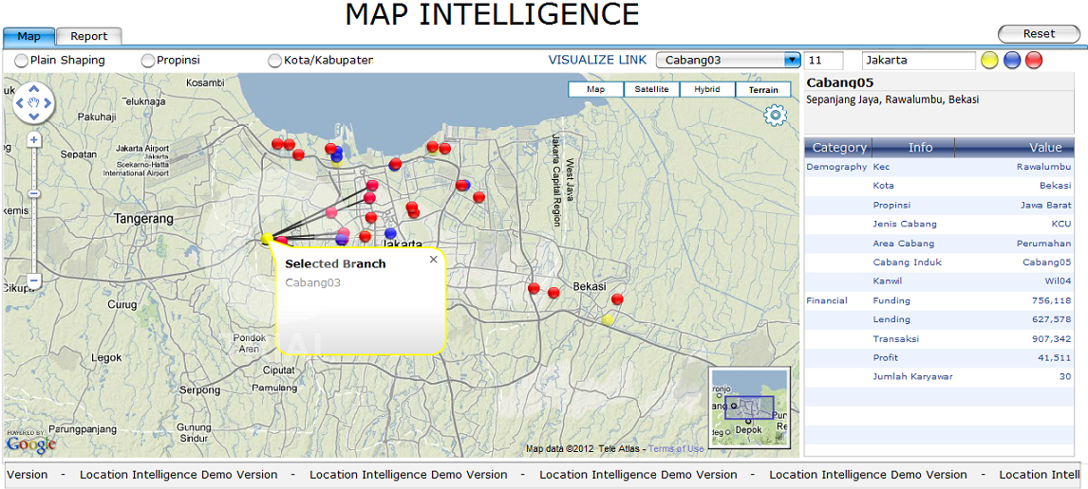

Slide 42
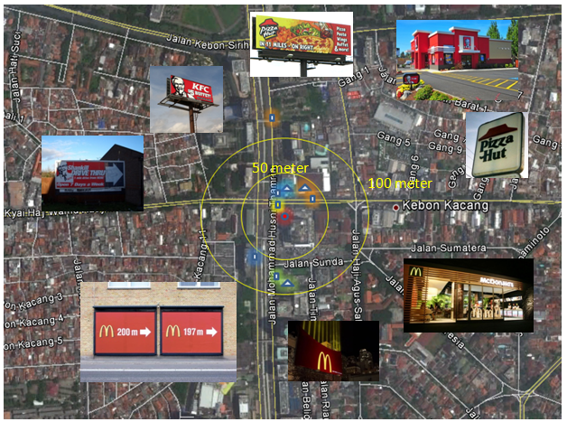
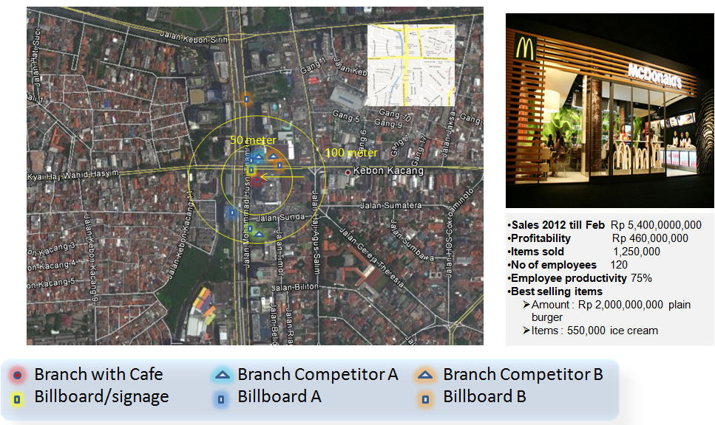
Mapping competitor by Radius….

Slide 43
Turning Big Data into Value:
Value
The ‘Datafication’ of our World;
Activities
Conversations
Words
Voice
Social Media
Browser logs
Photos
Videos
Sensors
Etc.
Volume
Analysing
Big Data:
Text analytics
Sentiment analysis
Face recognition
Voice analytics
Movement analytics
Etc.
Velocity
Variety
Veracity

Slide 44
How is Big Data actually used? Example 1
Better understand and target customers:
To better understand and target customers, companies expand their traditional data sets with social media data, browser, text analytics or sensor data to get a more complete picture of their customers. The big objective, in many cases, is to create predictive models. Using big data, Telecom companies can now better predict customer churn; retailers can predict what products will sell, and car insurance companies understand how well their customers actually drive.

Slide 45
How is Big Data actually used? Example 2
Understand and Optimize Business Processes:
Big data is also increasingly used to optimize business processes. Retailers are able to optimize their stock based on predictive models generated from social media data, web search trends and weather forecasts. Another example is supply chain or delivery route optimization using data from geographic positioning and radio frequency identification sensors.

Slide 46
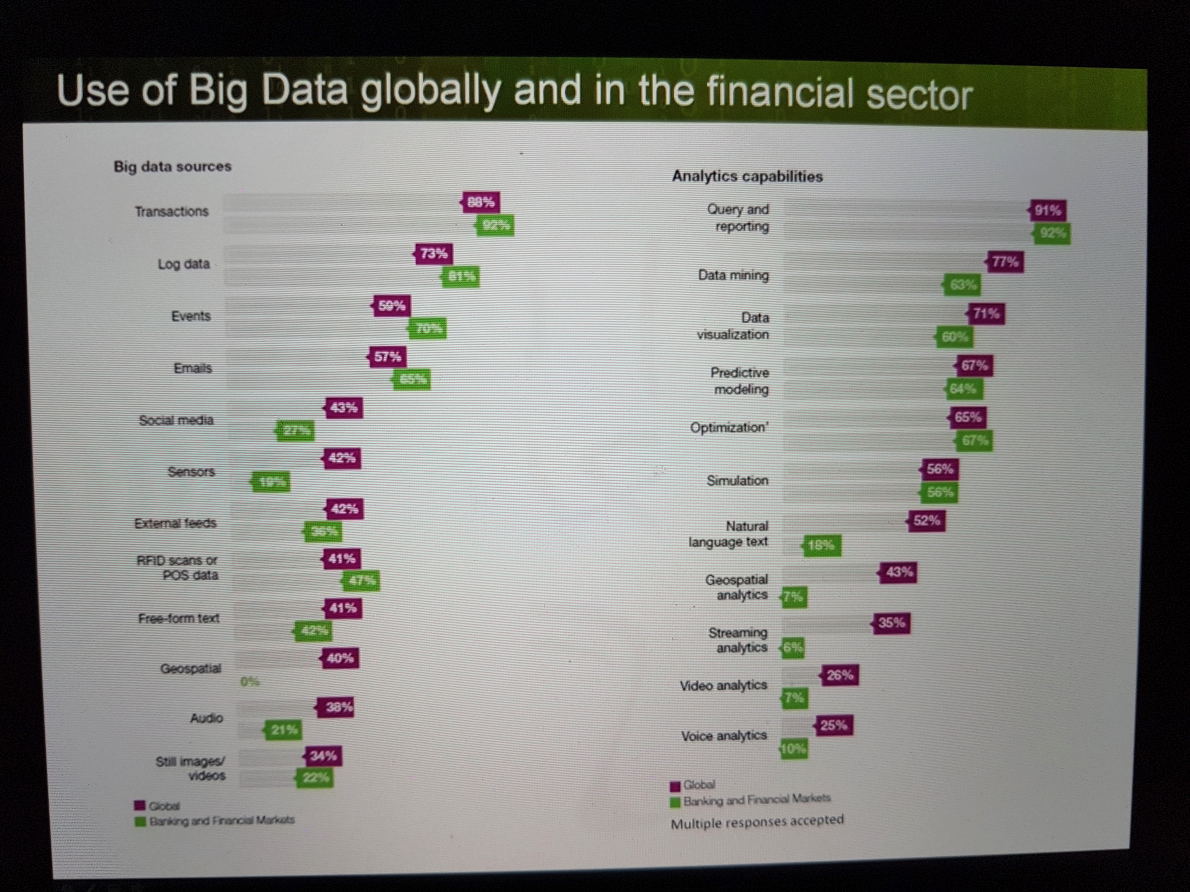
(Brody & Pureswaran, 2015)
Sage-Fox.com Free PowerPoint Templates

Slide 47
1
Every minute
we send 204 million emails, generate 1,8 million Facebook likes, send 278 thousand Tweets, and up-load 200,000 photos to Facebook.
Source

Slide 48
2
Google alone processes on average over 40 thousand search queries per second, making it over 3.5 billion in a single day.
Source

Slide 49
3
Around 100
hours of video are uploaded to YouTube every minute and it would take you around 15 years to watch every video uploaded by users
in one day.
Source

Slide 50
4
570 new
websites spring into existence every minute of every day.
Source

Slide 51
5
1.9 million
IT jobs will be
created in the US
by 2015 to carry out big data projects. Each of those will be supported by 3 new jobs created outside of IT – meaning a total of 6 million new jobs thanks to
big data.
Source

Slide 52
6
Between them, companies monitoring Twitter to measure “sentiment” analyze 12 terabytes of tweets every day.
Source

Slide 53
7
Big data has been
used to predict crimes
before they happen – a “predictive policing” trial in California was able to identify areas where crime will occur three times more accurately than existing methods of forecasting.
Source

Slide 54
8
Retailers could increase their profit margins by more than 60% through the full exploitation of big data analytics.
Source

Slide 55
9
The big data industry is expected to grow from US$10.2 billion in 2013 to about US$54.3 billion by 2017.
Source

Slide 56
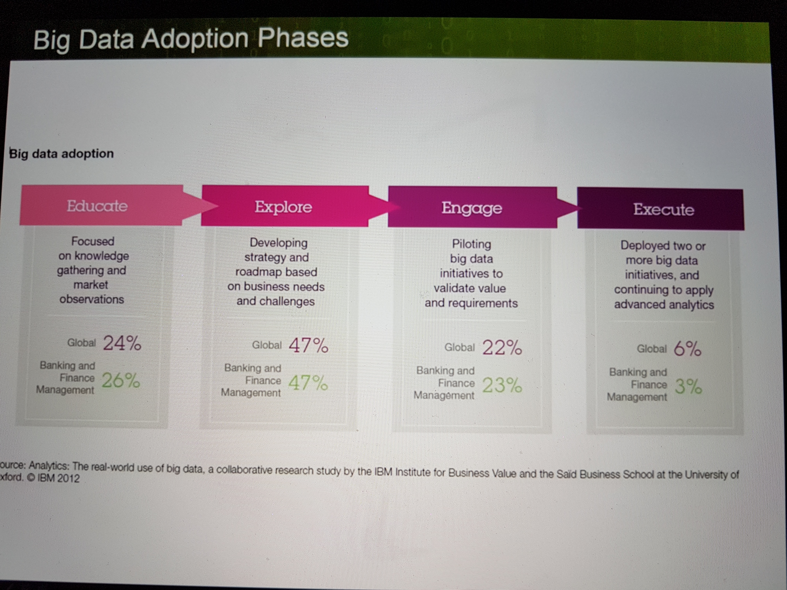

Slide 57
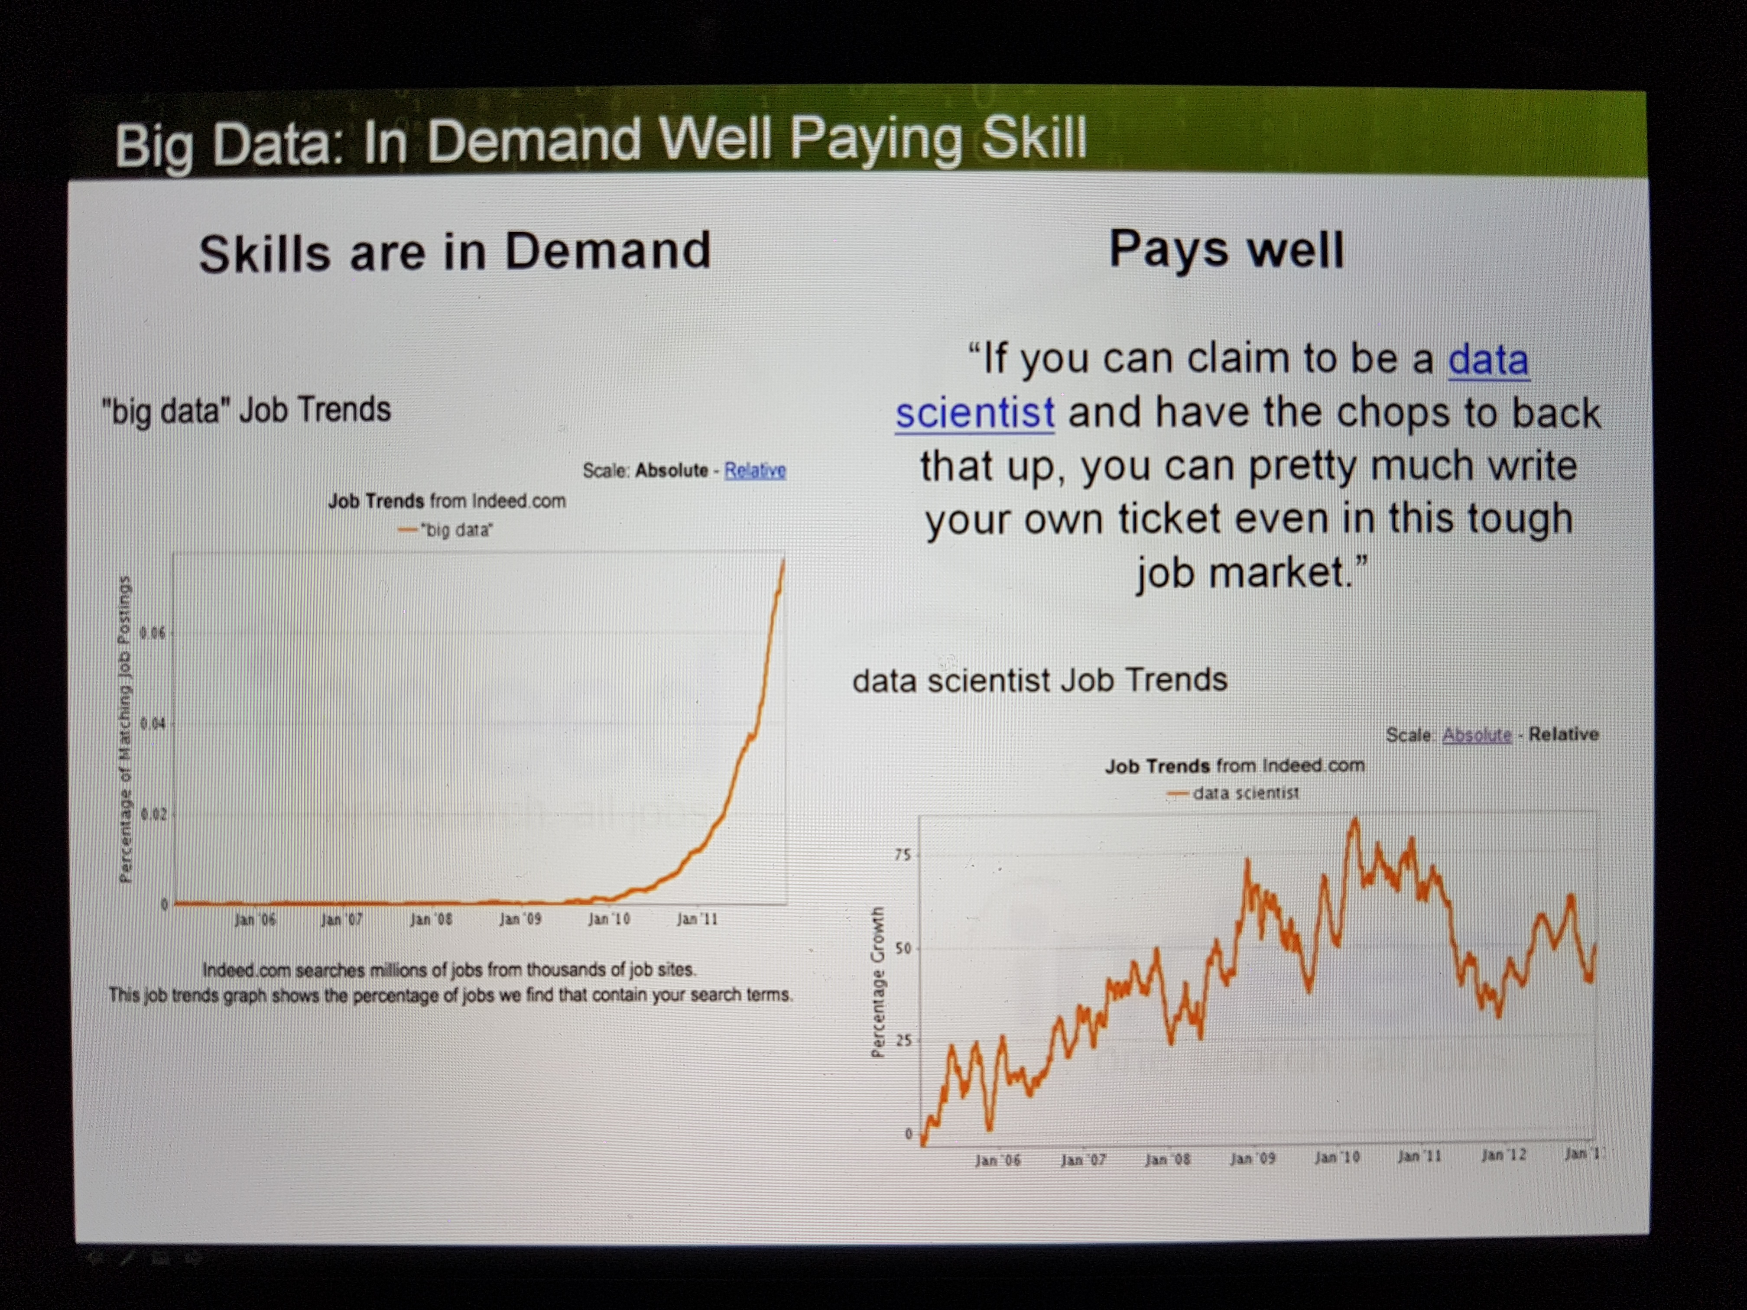

Slide 58
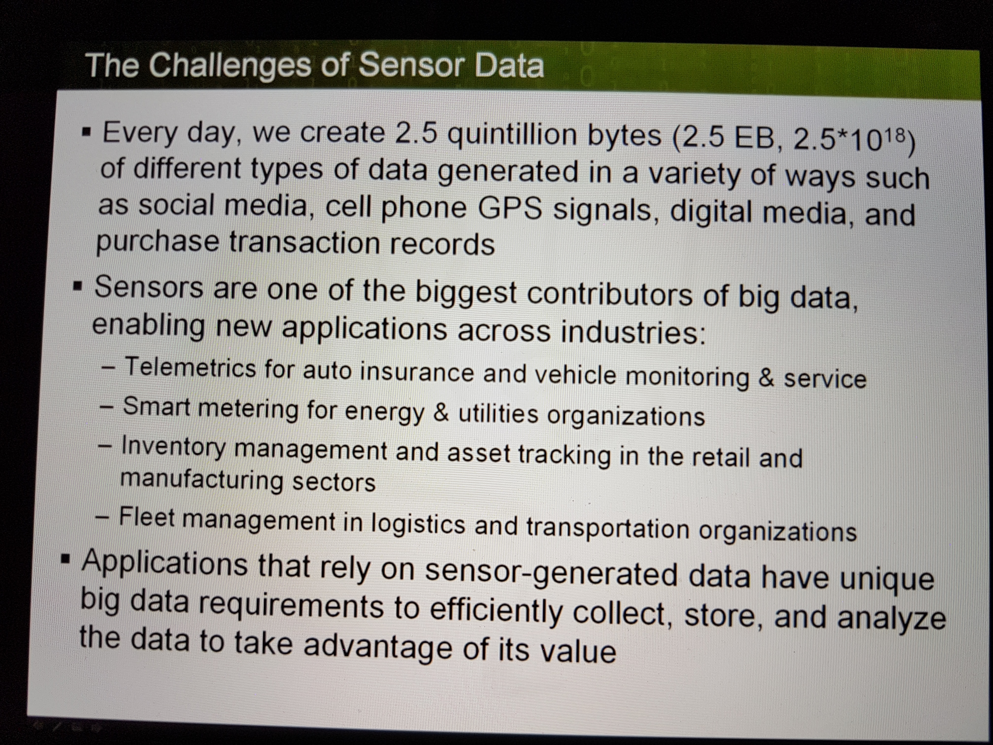

Slide 59
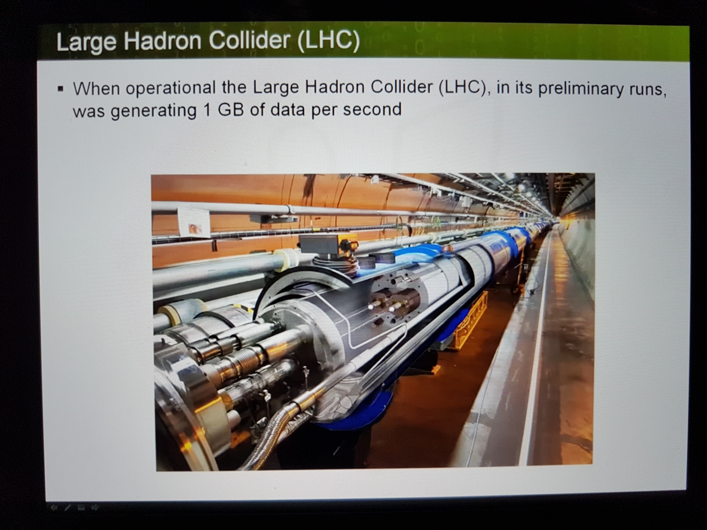

Slide 60
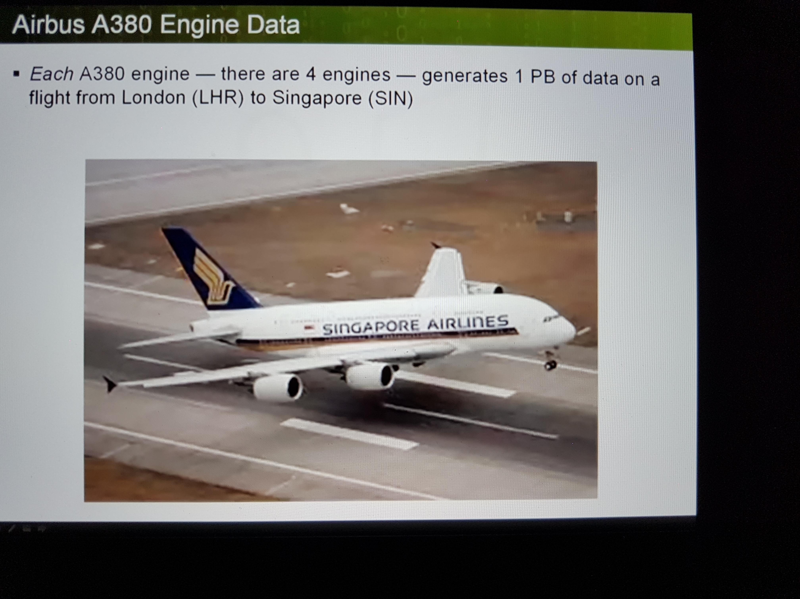

Slide 61







WHERE WE WORK
ZALORA as part of Rocket Internet’s
Global Fashion Group (GFG)
GFG addresses a fashion market of over 330 billion euros, targeting a population of 2.5 billion
200m+
€75bn
4.2%
50m+
€23bn
0.1%
570m+
€62bn
3.1%
420m+
€131bn
1.4%
1,240m+
€42bn
0.6%
Argentina ᆞ Australia ᆞ Bahrain ᆞ Brazil ᆞ Chile ᆞ Colombia ᆞ India ᆞ Indonesia ᆞ Kazakhstan ᆞ Kuwait ᆞ Malaysia ᆞ Mexico ᆞ New Zealand ᆞ Oman ᆞ Philippines ᆞ Qatar ᆞ Russia ᆞ Saudi Arabia ᆞ Singapore ᆞ Thailand ᆞ UAE ᆞ Ukraine ᆞ Vietnam

Slide 62


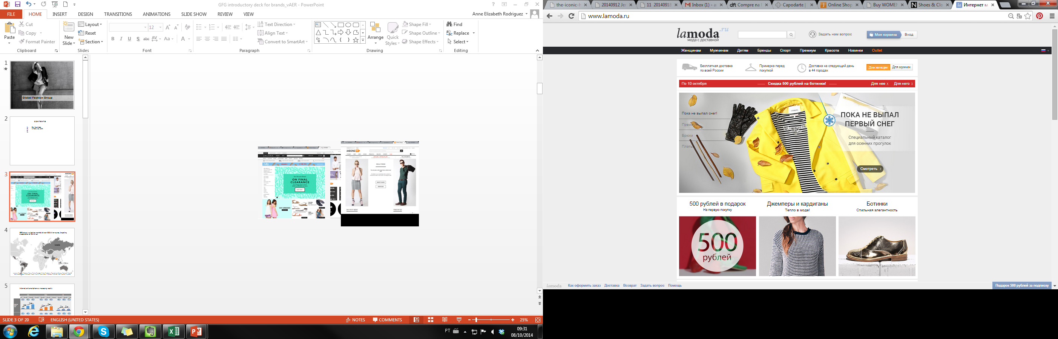
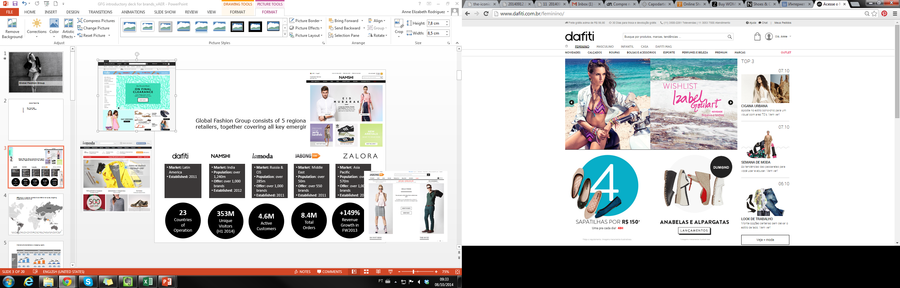
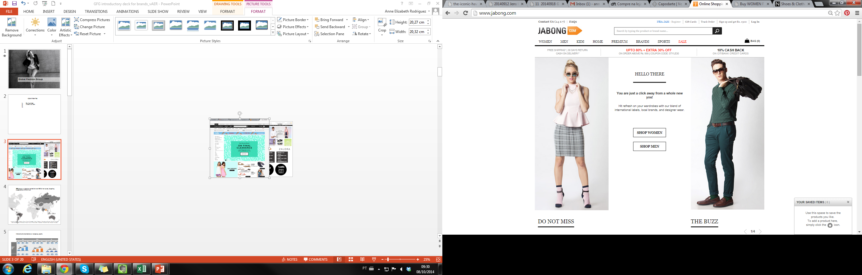

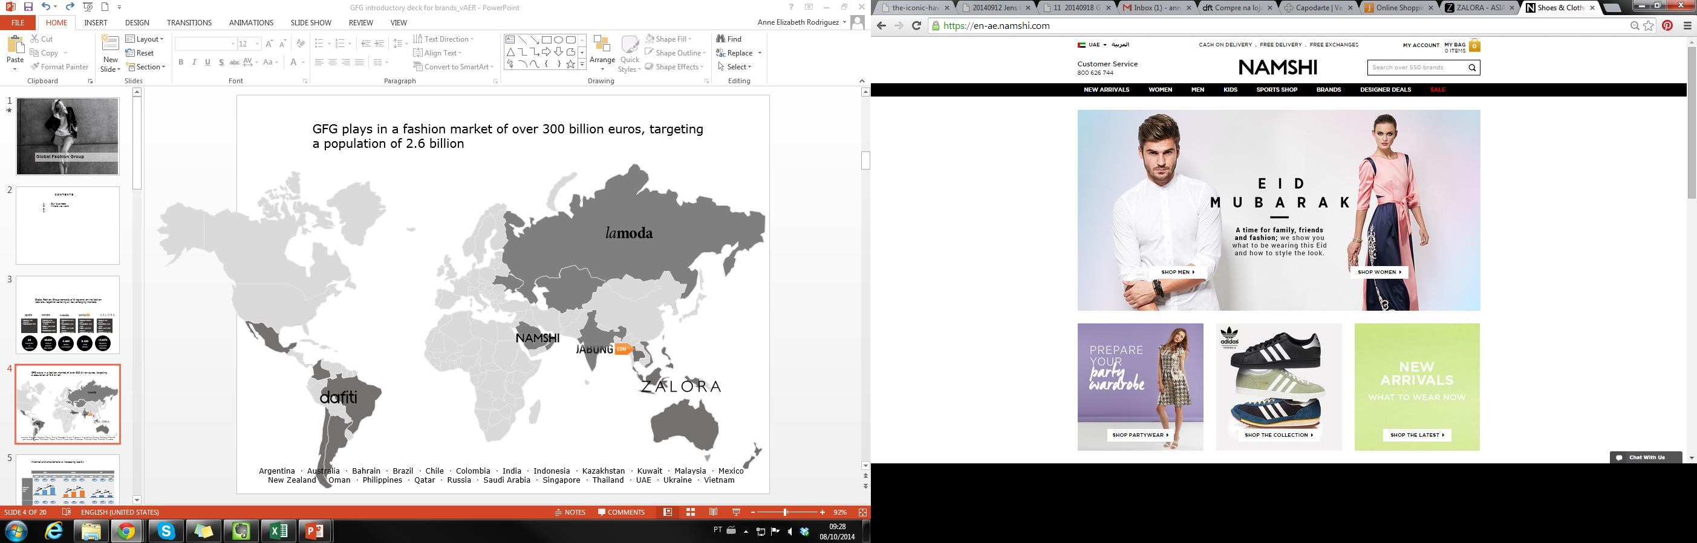
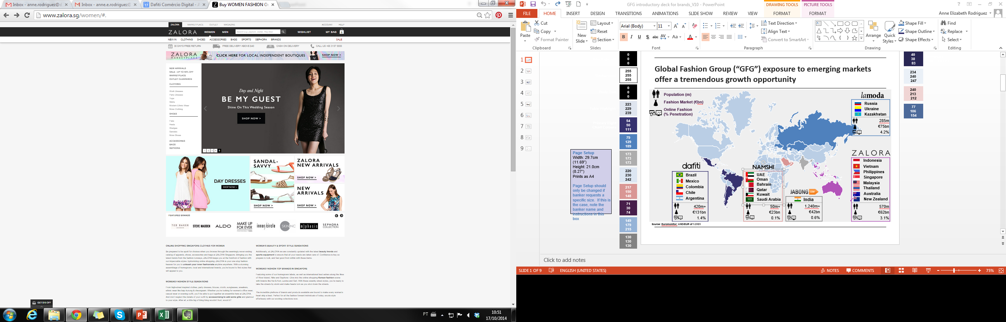
INTRO TO GFG
Global Fashion Group, “GFG” consists of 5 regional online fashion retailers, together covering all key emerging markets
Russia & CIS
Latin America
India
Middle East
Asia Pacific

Slide 63
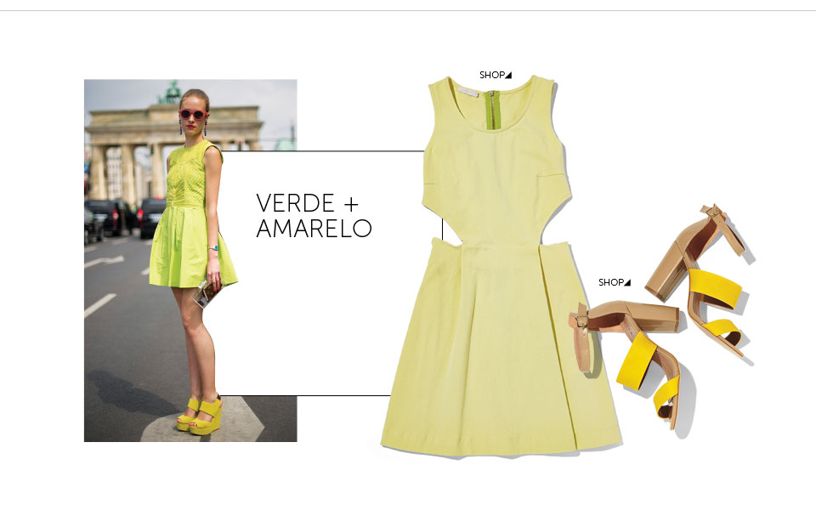

OUR BUSINESS
GFG strives to be the number one fashion e-commerce in emerging markets
23
Countries of Operation
353M
Unique Visitors
(H1 2014)
4.6M
Active Customers
8.4M
Total Orders
+149%
Revenue Growth in FW2013

Slide 64































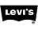



OUR BRANDS
We offer a wide range of 3000+ brands on our sites offering a full spectrum of price ranges and levels of fashionability

Slide 65




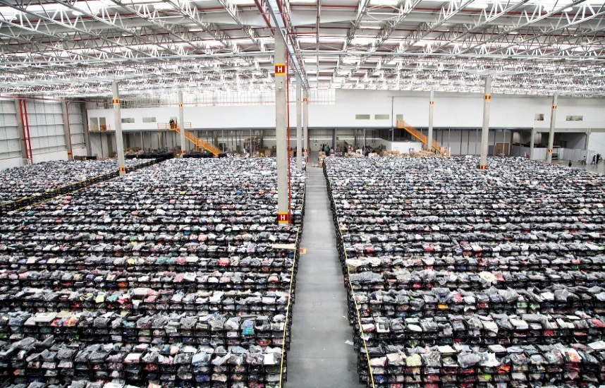
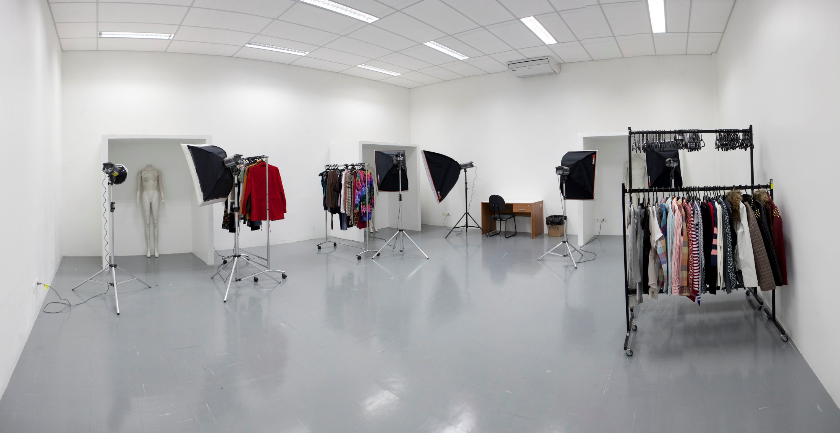
HOW WE OPERATE
GFG offers its customers convenience and reliability, through top logistics and customer service
DISTRIBUTION CENTER
CUSTOMER SERVICE
DELIVERY
E-PRODUCTION
15 DCs globally to allow for rapid fulfillment and delivery
Free delivery
Free returns for 14-365 days, depending on country
Cash on delivery available in 20 of 23 countries
Next-day delivery available in all markets
High quality, quick shooting
3D photo shoot, catwalk videos, and virtual try-on
indeed.com.br
justdial.com
market.yandex.ru
yadig.com
thesmartlocal.com

Slide 66


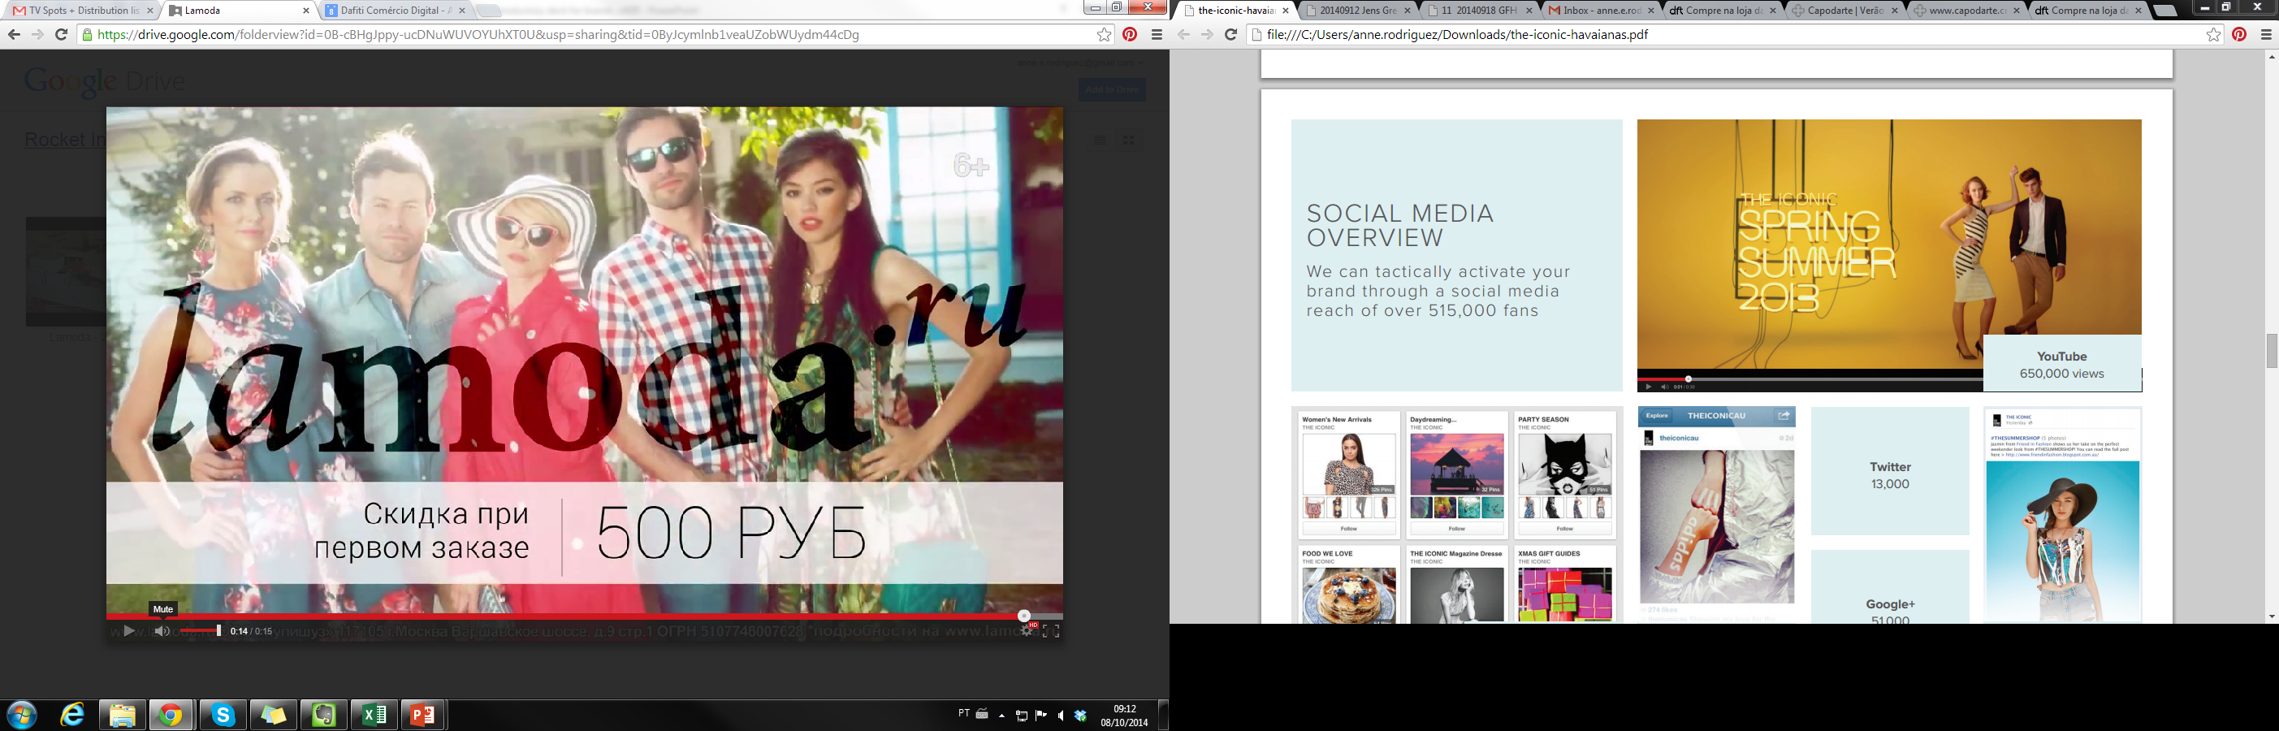
MARKETING INITIATIVES
We are experts in engaging new and existing customers through multiple channels in all of our markets
Website
85M unique site vistors/month
Social Media
>17 million followers on social media
Online
In-house SEM, SEO, display and affiliate
TV
TV spots across major networks
CRM
Client base of
>12 million
Magazine
Total circulation of 6M copies per year
Bloggers
Partnerships with key fashion bloggers in each of our 23 markets
Mobile
10M downloads of GFG apps

Slide 67




































































800+ Brands on Zalora, 95% Sourced Locally
Source: Company Information

Slide 68




We just migrated to the largest ecommerce WH in Indonesia (possibly largest in SEA)
15 000 sqm distributed across 3 floors
More scalable inbound and outbound
More reliable inventory mgmt

Slide 69

How we do data driven ecommerce

Slide 70


Data collection across dimensions
We collect data in every possible dimension, including:
Clickstream behavior
Purchase behavior
Inventory flow
Revenue and cost
Using sophisticated BI tools and systems, we gain data driven insights and personalize the customer experience

Slide 71



Retargeting
Retargeting uses information pulled from cookies. Content displayed reflects products that the user previously viewed on our website.
We observed significant improvements in terms of revenue per impression and CTR

Slide 72




We continuously track performance with various KPIs – example from Customer Service
100%

Slide 73

Sorting Algorithm
We rank a large number of SKUs and determine their position in the catalogue page
Goal: Maximize a predefined output variable per catalog impression while maintaining a diversity in brands, discounts and price points
Key challenges: Limited historical data, sheer data size and complexity

Slide 74

Indosat Fashion Big Bang
Delivering an outstanding customer experience, even in extreme situations.

Slide 75


CRM - Newsletter
Customized newsletter frequency
Segment specific newsletters (e.g. Muslim wear campaign, reactivation campaigns)
Birthday deals, abandoned cart reminders

Slide 76
TRADITIONAL VS DIGITAL MARKETING
- CUSTOMER LIFETIME VALUE > COST PER CUSTOMER ACQUISITION
CUSTOMER LIFETIME VALUE = BASKET SIZE X GROSS MARGIN X FREQUENCY X REMAINING YEARS OF LIFE = RP 400K X 40% X 3 X 15 YRS = RP 7.5 MIO
COST PER ACQUISITION (CPA) = ACQUISITION COST (CPC) + ACTIVATION COST (2A’s) = RP 200K
4R’s = Revenue + Referral + Retention + Resurrection
- CUSTOMER VALUE = PERCEIVED VALUE (BRANDING - PACKAGING)
PERCEIVED RISK (MONEY BACK GUARANTEE)
HACKING GROWTH & COHORT ANALYSIS

Slide 77
Thank You !
Sage-Fox.com Free PowerPoint Templates
Notes:
Digital marketing:
Search Engine Optimization (SEO)
Search Engine Marketing (SEM)
Content Creation & Content Marketing
Social Media Marketing (SMM)
Digital Display Advertising
Retargeting and Remarketing
Mobile Marketing
Email Marketing
Affiliate Marketing
Digital Media Planning and Buying

